Slide 1
The RSA Trapdoor Permutation
CS255: Intro. to Crypto Dan Boneh

Slide 2
Recap
Public key encryption: (Gen, E, D)
Gen() ⟶ (pk, sk) , E(pk, m) ⟶ c , D(sk, c) ⟶ m
Constructions: (1) ElGamal encryption, (2) today: RSA
Security from last lecture:
semantic security against an eavesdropper
In practice security against eavesdropping is insufficient:
adversary can make up ciphertexts
and see how recipient reacts

Slide 3






Security against chosen ciphertext attacks (CCA)
A PKE (Gen, E, D) is chosen-ciphertext secure if no ”efficient” adversary can win the following game with non-negl. advantage:
$$pk$$
chal.
adv.
b ∈ {0,1}
$$\left(pk, sk\right)⟵Gen()$$
encryption query: $m0, m1$ (equal len)
$$c←E(pk, mb)$$
↻
decryption queries: $ci ≠ c$
b’ ∈ {0,1}
D$(sk, ci)$
Thm: ElGamal encryption from last lecture is CCA secure assuming
interactive-CDH in G holds, and H is a modeled as a random oracle

Slide 4
Recap
Public key encryption: (Gen, E, D)
Gen() ⟶ (pk, sk) , E(pk, m) ⟶ c , D(sk, c) ⟶ m
Security: semantic security against a chosen-ciphertext attack
Semantic security against adv. that can issue decryption queries
Constructions: (1) ElGamal encryption, (2) today: RSA
… but first: trapdoor functions

Slide 5
Trapdoor functions (TDF)
Def: a trapdoor func. X⟶Y is a triple of efficient algs. (Gen, F, F⁻¹)
Gen(): randomized alg. outputs a key pair (pk, sk)
F(pk,⋅): det. alg. that defines a function X ⟶ Y
F⁻¹(sk,⋅): defines a function Y ⟶ X that inverts F(pk,⋅)
More precisely: ∀(pk, sk) output by Gen
∀x∈X: F⁻¹(sk, F(pk, x) ) = x

Slide 6
Secure Trapdoor Functions (TDFs)
(Gen, F, F⁻¹) is secure if F(pk, ⋅) is a “one-way” function:
can be evaluated, but cannot be inverted without sk
Chal.
Adv. A
(pk,sk)←Gen()
x ⟵ X
R
pk, y ← F(pk, x)
x’
Def: (Gen, F, F⁻¹) is a secure TDF if for all efficient A:
Adv_{OW} [A,F] = Pr[ x = x’ ] < negligible

Slide 7
Public-key encryption from TDFs
(Gen, F, F⁻¹): secure TDF X ⟶ Y
(E_{s}, D_{s}) : symmetric auth. encryption defined over (K,M,C)
H: X ⟶ K a hash function
We construct a pub-key enc. system (Gen, E, D):
Key generation Gen: same as Gen for TDF

Slide 8
Public-key encryption from TDFs
(Gen, F, F⁻¹): secure TDF X ⟶ Y
(E_{s}, D_{s}) : symmetric auth. encryption defined over (K,M,C)
H: X ⟶ K a hash function
E( pk, m) :
x ⟵ X, y ⟵ F(pk, x)
k ⟵ H(x), c ⟵ E_{s}(k, m)
output (y, c)
D( sk, (y,c) ) :
x ⟵ F⁻¹(sk, y),
k ⟵ H(x), m ⟵ D_{s}(k, c)
output m
R

Slide 9
In pictures:
Security Theorem:
If (Gen, F, F⁻¹) is a secure TDF, (E_{s}, D_{s}) provides auth. enc.
and H: X ⟶ K is a “random oracle”
then (Gen,E,D) is CCA^{ro} secure.
F(pk, x)
E_{s}( H(x), m )
header
body
Notes:
Need to explain what is a random oracle. NEVER encrypt m directly with RSA.

Slide 10
Incorrect use of a Trapdoor Function (TDF)
Never encrypt by applying F directly to plaintext:
Problems:
Deterministic: cannot be semantically secure !!
Many attacks exist (coming)
E( pk, m) :
output c ⟵ F(pk, m)
D( sk, c ) :
output F⁻¹(sk, c)

Slide 11
The RSA trapdoor permutation

Slide 12
Review: arithmetic mod composites
Let N = p⋅q where p,q are prime
ℤ_{N} = {0,1,2,…,N-1} ; (ℤ_{N})* = {invertible elements in Z_{N}}
Facts: x ∈ ℤ_{N} is invertible ⇔ gcd(x,N) = 1
  Number of elements in (ℤ_{N})* is ϕ(N) = (p-1)(q-1) = N-p-q+1
Euler’s thm: ∀ x∈ (ℤ_{N})* : x^{ϕ(N)} = 1
Notes:
A random element in Z_N is *very* likely to be in Z_N^*

Slide 13
The RSA trapdoor permutation
First published: Scientific American, Aug. 1977.
Applications:
  HTTPS: web certificates (… but less and less so)
  deprecated for key exchange in TLS 1.3

Slide 14

The RSA trapdoor permutation
Gen(): choose random distinct primes p,q ≈1024 bits.
Set N=pq.
choose integers e , d s.t. e⋅d = 1 (mod ϕ(N) )
output pk = (N, e) , sk = (N, d)
F( pk, x ): ; RSA(x) = x^{e} (in ℤ_{N})
F⁻¹( sk, y) = y^{d} ; y^{d} = RSA(x)^{d} = x^{ed} = x^{kϕ(N)+1} = (x^{ϕ(N)})^{k} ⋅ x = x

Slide 15
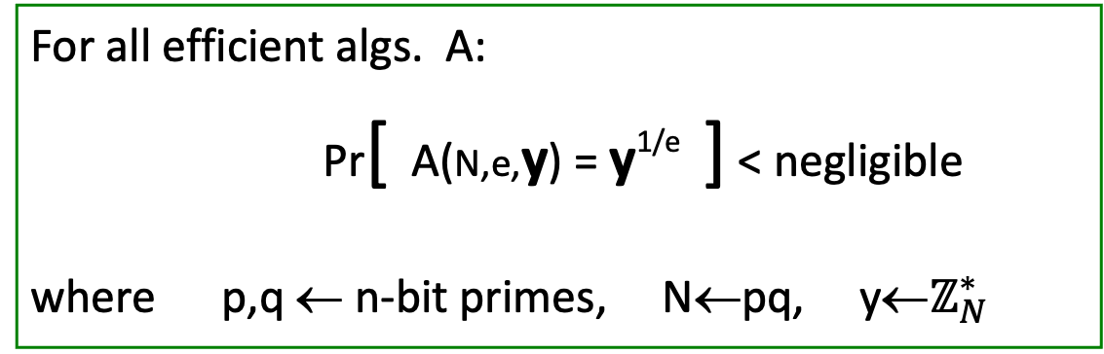
The RSA assumption
RSA_{e} assumption: RSA with exp. e is a one-way permutation
For all efficient algs. A:
Pr[ A(N,e,y) = y^{1/e} ] < negligible
where p,q ← n-bit primes, N←pq, y←$ℤ_{N}^{∗}$
R
R

Slide 16
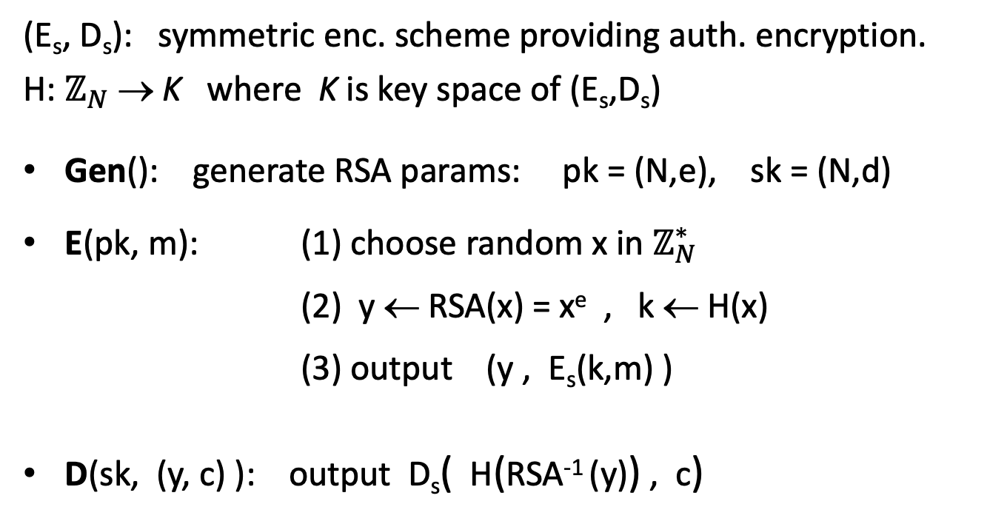
RSA pub-key encryption (ISO std)
(E_{s}, D_{s}): symmetric enc. scheme providing auth. encryption.
H: $ℤ_{N}$ → K where K is key space of (E_{s},D_{s})
Gen(): generate RSA params: pk = (N,e), sk = (N,d)
E(pk, m): (1) choose random x in $ℤ_{N}^{∗}$
(2) y ← RSA(x) = x^{e} , k ← H(x)
(3) output (y , E_{s}(k,m) )
D(sk, (y, c) ): output D_{s}( H(RSA⁻¹ (y)) , c)
Notes:
AE-secure: the scheme provides Authenticated Encryption.
Resulting system is chosen ciphertext secure (in the random oracle model).

Slide 17
Textbook RSA is insecure
Textbook RSA encryption:
  public key: (N,e) Encrypt: c ⟵ m^{e} (in ℤ_{N})
  secret key: (N,d) Decrypt: c^{d} ⟶ m
Insecure cryptosystem !!
  Is not semantically secure and many attacks exist
⇒ The RSA trapdoor permutation is not an encryption scheme !

Slide 18
A simple attack on textbook RSA
CLIENT HELLO
random
session-key k
Web
Browser
Web
Server
SERVER HELLO (N,e)
d
c=RSA(k)
Suppose k is 64 bits: k ∈ {0,…,2⁶⁴}. Eve sees: c= k^{e} in ℤ_{N}
If k = k₁⋅k₂ where k₁, k₂ < 2³⁴ (prob. ≈20%) then c/k₁e = k₂e in ℤ_{N}
Step 1: build table: c/1e, c/2e, c/3e, …, c/2^{34e} . time: 2³⁴
Step 2: for k₂ = 0,…, 2³⁴ test if k₂e is in table. time: 2³⁴
Output matching (k₁, k₂). Total attack time: ≈2³⁴ << 2⁶⁴

Slide 19
RSA in practice

Slide 20
RSA encryption in practice
Never use textbook RSA.
RSA in practice (since ISO standard is not often used) :
Main questions:
  How should the preprocessing be done?
  Can we argue about security of resulting system?
msg
key
Preprocessing
ciphertext
RSA
Notes:
ISO standard is the “full domain hash” method discussed in lecture.

Slide 21
PKCS1 v1.5
PKCS1 mode 2: (encryption)
Resulting value is RSA encrypted
Widely deployed, e.g. in HTTPS (TLS 1.2) -- now deprecated
16 bits
02
random pad
00
msg
RSA modulus size (e.g. 2048 bits)
Notes:
HTTPS: msg is 384 bits (48 bytes)

Slide 22
Attack on PKCS1 v1.5 (Bleichenbacher 1998)
PKCS1 used in HTTPS:
  ⇒ attacker can test if 16 MSBs of plaintext = ’02’
Chosen-ciphertext attack: to decrypt a given ciphertext c do:
  Choose r ∈ ℤ_{N}. Compute c’ ⟵ r^{e}⋅c = (r ⋅ PKCS1(m))^{e}
  Send c’ to web server and use response
c=
ciphertext
c
Is this
PKCS1?
Web
Server
Attacker
d
yes: continue
no: error
02

Slide 23
Baby Bleichenbacher
compute x⟵c^{d} in ℤ_{N}
c=
ciphertext
c
is msb=1?
Web
Server
Attacker
d
yes: continue
no: error
1
Suppose N is N = 2^{n} (an invalid RSA modulus). Then:
Sending c reveals msb( x )
Sending 2e⋅c = (2x)^{e} in Z_{N} reveals msb(2x mod N) = msb₂(x)
Sending 4e⋅c = (4x)^{e} in Z_{N} reveals msb(4x mod N) = msb₃(x)
… and so on to reveal all of x
Notes:
Attack generalizes to other N.

Slide 24
HTTPS Defense (RFC 5246)
Attacks discovered by Bleichenbacher and Klima et al. … can be avoided by treating incorrectly formatted message blocks … in a manner indistinguishable from correctly formatted RSA blocks. In other words:
1. Generate a string R of 46 random bytes
2. Decrypt the message to recover the plaintext M
3. If the PKCS#1 padding is not correct
pre_master_secret = R

Slide 25
PKCS1 v2.0: OAEP
New preprocessing function: OAEP [BR94]
Thm [FOPS’01] : RSA is a trap-door permutation ⇒
RSA-OAEP is CCA secure when H,G are random oracles
in practice: use SHA-256 for H and G
00..0
01
msg
rand.
check pad
on decryption.
reject CT if invalid.
+
H
G
+
∈{0,1}^{n-1}
plaintext to encrypt with RSA
Notes:
OAEP: explain why O stands for Optimal.
Fujisaki, Okamoto, Pointcheval and Stern

Slide 26
OAEP Improvements
OAEP+: [Shoup’01]
∀ trap-door permutation F
F-OAEP+ is CCA secure when
H,G,W are random oracles.
SAEP+: [B’01]
RSA (e=3) is a trap-door perm ⇒
RSA-SAEP+ is CCA secure when
H,W are random oracle.
m
W(m,r)
r
+
H
G
+
During decryption validate W(m,r) field.
m
W(m,r)
r
+
H

Slide 27
Subtleties in implementing OAEP [M ’00]
OAEP-decrypt(ct):
error = 0;
if ( RSA⁻¹(ct) > 2^{n-1} )
{ error =1; goto exit; }
if ( pad(OAEP⁻¹(RSA⁻¹(ct))) != “01000” )
{ error = 1; goto exit; }
Problem: timing information leaks type of error
  ⇒ Attacker can decrypt any ciphertext
Lesson: Don’t implement RSA-OAEP yourself !

Slide 28
Is RSA a one-way function?

Slide 29
Is RSA a one-way permutation?
To invert the RSA one-way func. (without d) attacker must compute:
x from c = x^{e} (mod N).
How hard is computing e’th roots modulo N ??
Best known algorithm:
  Step 1: factor N (hard)
  Step 2: compute e’th roots modulo p and q (easy)

Slide 30
Shortcuts?
Must one factor N in order to compute e’th roots?
To prove no shortcut exists show a reduction:
  Efficient algorithm for e’th roots mod N
  ⇒ efficient algorithm for factoring N.
  Oldest open problem in public key cryptography.
Some evidence no reduction exists: (BV’98)
  “Algebraic” reduction ⇒ factoring is easy.
Notes:
But a natural question is, is it true that in order to compute e’th roots modulo N we have to factor the modulus.

Slide 31
How not to improve RSA’s performance
To speed up RSA decryption use small private key d ( d ≈ 2¹²⁸ )
c^{d} = m (mod N)
Wiener’87: if d < N^{0.25} then RSA is insecure.
BD’98: if d < N^{0.292} then RSA is insecure (open: d < N^{0.5} )
Insecure: priv. key d can be found from (N,e)
Notes:
Small d should never be used.

Slide 32
Wiener’s attack
Recall: e⋅d = 1 (mod ϕ(N) ) ⇒ ∃ k∈Z : e⋅d = k⋅ϕ(N) + 1
ϕ(N) = N-p-q+1 ⇒ |N − ϕ(N)| ≤ p+q ≤ 3√N
d ≤ N^{0.25}/3 ⇒
Continued fraction expansion of e/N gives k/d.
e⋅d = 1 (mod k) ⇒ gcd(d,k)=1 ⇒ can find d from k/d

Slide 33
Wiener’s attack
Recall: e⋅d = 1 (mod ϕ(N) ) ⇒ ∃ k∈Z : e⋅d = k⋅ϕ(N) + 1
ϕ(N) = N-p-q+1 ⇒ |N − ϕ(N)| ≤ p+q ≤ 3√N
d ≤ N^{0.25}/3 ⇒
Continued fraction expansion of e/N gives k/d.
e⋅d = 1 (mod k) ⇒ gcd(d,k)=1 ⇒ can find d from k/d

Slide 34
Wiener’s attack
Recall: e⋅d = 1 (mod ϕ(N) ) ⇒ ∃ k∈Z : e⋅d = k⋅ϕ(N) + 1
ϕ(N) = N-p-q+1 ⇒ |N − ϕ(N)| ≤ p+q ≤ 3√N
d ≤ N^{0.25}/3 ⇒
Continued fraction expansion of e/N gives k/d.
e⋅d = 1 (mod k) ⇒ gcd(d,k)=1 ⇒ can find d from k/d

Slide 35
Wiener’s attack
Recall: e⋅d = 1 (mod ϕ(N) ) ⇒ ∃ k∈Z : e⋅d = k⋅ϕ(N) + 1
ϕ(N) = N-p-q+1 ⇒ |N − ϕ(N)| ≤ p+q ≤ 3√N
d ≤ N^{0.25}/3 ⇒
Continued fraction expansion of e/N gives k/d.
e⋅d = 1 (mod k) ⇒ gcd(d,k)=1 ⇒ can find d from k/d

Slide 36
RSA With Low public exponent
To speed up RSA encryption use a small e: c = m^{e} (mod N)
Minimum value: e=3 ( gcd(e, ϕ(N) ) = 1)
Recommended value: e=65537=2¹⁶+1
Encryption: 17 multiplications
Asymmetry of RSA: fast enc. / slow dec.
  ElGamal: approx. same time for both.

Slide 37
Key lengths
Security of public key system should be comparable to security of symmetric cipher:
RSA
Cipher key-size Modulus size
80 bits 1024 bits
128 bits 3072 bits
256 bits (AES) 15360 bits
Best factoring algorithm (GNFS): n-bits integer, time ≈
Elliptic Curve
Modulus size
160 bits
256 bits
512 bits

Slide 38
Implementation attacks
Timing attack: [Kocher et al. 1997] , [BB’04]
The time it takes to compute c^{d} (mod N) can expose d
Power attack: [Kocher et al. 1999)
The power consumption of a smartcard while
it is computing c^{d} (mod N) can expose d.
Faults attack: [BDL’97]
A computer error during c^{d} (mod N) can expose d.
A common defense:: check output. 10% slowdown.
Notes:
BB’04: Boneh-Brumley

Slide 39
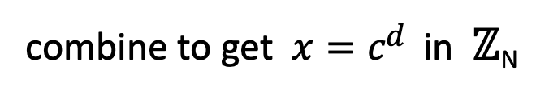
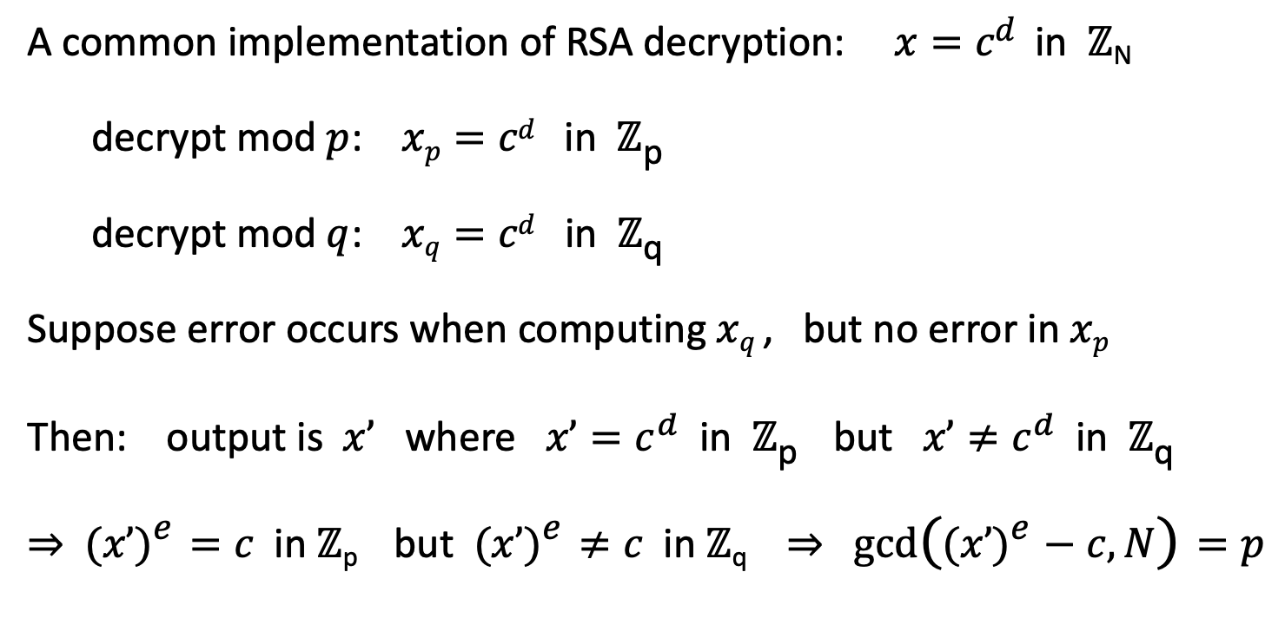
An Example Fault Attack on RSA (CRT)
A common implementation of RSA decryption: $x=cd$in ℤ_{N}
decrypt mod $p$: $xp=cd$in ℤ_{p}
decrypt mod $q$: $xq=cd$in ℤ_{q}
Suppose error occurs when computing $xq$ , but no error in $xp$
Then: output is $x’$ where $x’=c^{d}$ in ℤ_{p} but $x’≠c^{d}$in ℤ_{q}
⇒ $(x’)e=c$in ℤ_{p} but $(x’)e≠c$in ℤ_{q} ⇒ $gcd⁡((x’)e−c, N)=p$
combine to get $x=cd$in ℤ_{N}

Slide 40
RSA Key Generation Trouble [Heninger et al./Lenstra et al.]
OpenSSL RSA key generation (abstract):
Suppose poor entropy at startup:
Same p will be generated by multiple devices, but different q
N₁ , N₂ : RSA keys from different devices ⇒ gcd(N₁,N₂) = p
prng.seed(seed)
p = prng.generate_random_prime()
prng.add_randomness(bits)
q = prng.generate_random_prime()
N = p*q

Slide 41
RSA Key Generation Trouble [Heninger et al./Lenstra et al.]
Experiment: factors 0.4% of public HTTPS keys !!
Lesson:
  Make sure random number generator is properly
  seeded when generating keys

Slide 42
THE END

