Slide 1


Charm++
Motivations and Basic Ideas
Laxmikant (Sanjay) Kale
http://charm.cs.illinois.edu
Parallel Programming Laboratory
Department of Computer Science
University of Illinois at Urbana Champaign

Slide 2
What is Charm++?
Charm++ is a generalized approach to writing parallel programs
  An alternative to the likes of MPI, UPC, GA etc.
  But not to sequential languages such as C, C++, and Fortran
Represents:
  The style of writing parallel programs
  The runtime system
  And the entire ecosystem that surrounds it
Three design principles:
  Overdecomposition, Migratability, Asynchrony

Slide 3
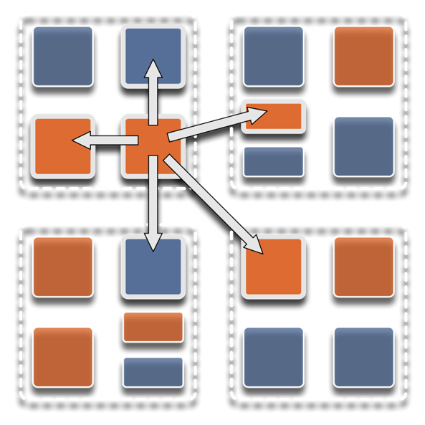
Overdecomposition
Decompose the work units & data units into many more pieces than execution units
  Cores/Nodes/..
Not so hard: we do decomposition anyway

Slide 4
Migratability
Allow these work and data units to be migratable at runtime
  i.e. the programmer or runtime, can move them
Consequences for the app-developer
  Communication must now be addressed to logical units with global names, not to physical processors
  But this is a good thing
Consequences for RTS
  Must keep track of where each unit is
  Naming and location management

Slide 5
Asynchrony: Message-Driven Execution
With over decomposition and Migratibility:
  You have multiple units on each processor
  They address each other via logical names
Need for scheduling:
  What sequence should the work units execute in?
  One answer: let the programmer sequence them
    Seen in current codes, e.g. some AMR frameworks
  Message-driven execution:
    Let the work-unit that happens to have data (“message”) available for it execute next
    Let the RTS select among ready work units
    Programmer should not specify what executes next, but can influence it via priorities

Slide 6
Realization of this model in Charm++
Overdecomposed entities: chares
  Chares are C++ objects
  With methods designated as “entry” methods
    Which can be invoked asynchronously by remote chares
  Chares are organized into indexed collections
    Each collection may have its own indexing scheme
      1D, ..7D
      Sparse
      Bitvector or string as an index
  Chares communicate via asynchronous method invocations
    A[i].foo(….); A is the name of a collection, i is the index of the particular chare.

Slide 7
Parallel Address Space
Processor 0
Processor 1
Scheduler
Scheduler
Message Queue
Message Queue
Processor 2
Processor 3
Scheduler
Scheduler
Message Queue
Message Queue

Slide 8
Message-driven Execution
A[23].foo(…)
Processor 0
Processor 1
Scheduler
Scheduler
Message Queue
Message Queue
Notes:
Certain member functions of certain classes are globally visible
Invocation of a member function may lead to communication

Slide 9
Processor 0
Processor 1
Scheduler
Scheduler
Message Queue
Message Queue
Processor 2
Processor 3
Scheduler
Scheduler
Message Queue
Message Queue

Slide 10
Processor 0
Processor 1
Scheduler
Scheduler
Message Queue
Message Queue
Processor 2
Processor 3
Scheduler
Scheduler
Message Queue
Message Queue

Slide 11
Processor 0
Processor 1
Scheduler
Scheduler
Message Queue
Message Queue
Processor 2
Processor 3
Scheduler
Scheduler
Message Queue
Message Queue

Slide 12
Expression of control
Control is reactive, expressed asynchronously
  When this object gets that method invocation, it does xyz
Global “synchronization” is achieved in a non-blocking manner
  For example:
  A subset of object may contribute to a global reduction
  Neither those objects nor other objects need to block while the reduction is in progress
  Program logic that depends on the result of the reduction is triggered when the reduction completes.
Two constructs help bring back some ordering when appropriate
  Structured dagger: expresses dependencies between remote data (messages, method invocations) and local state
    This expressing life cycle of a Chare
  Threaded methods, which “block” for constructs such as futures

Slide 13
Data Model
Data is partitioned by the user into collections of chare objects
  Access to other’s data only via asynchronous method invocation
In addition, users can declare global read-only data structures
Advanced usage provides escape to processor-level data structures
Higher level abstractions built on top of Charm++ provide global data abstractions
  Multi-phase shared arrays (Look them up if interested)

Slide 14
Empowering the RTS
Adaptive
Runtime System
Introspection
Adaptivity
Asynchrony
Overdecomposition
Migratability

Slide 15
Charm++ Benefits
Over-decomposition
Scalable Tools
Automatic overlap of Communication and Computation
Message-driven execution
Perfect prefetch
compositionality
Emulation for Performance Prediction
Migratability
Fault Tolerance
Introspective and adaptive runtime system
Dynamic load balancing (topology-aware, scalable)
Temperature/Power/Energy Optimizations

Slide 16
Utility for Multi-cores, Many-cores, Accelerators:
Objects connote and promote locality
Message-driven execution
  A strong principle of prediction for data and code use
  Much stronger than principle of locality
    Can use to scale memory wall:
    Prefetching of needed data:
      into scratch pad memories, for example
Processor 1
Scheduler
Message Queue
Notes:
Replace figure with a new drawing

Slide 17
Impact on communication
Current use of communication network:
  Compute-communicate cycles in typical MPI apps
  The network is used for a fraction of time
  and is on the critical path
Current communication networks are over-engineered for by necessity
P1
P2
BSP based application

Slide 18
Impact on communication
With overdecomposition:
  Communication is spread over an iteration
  Adaptive overlap of communication and computation
P1
P2
Overdecomposition enables overlap

Slide 19
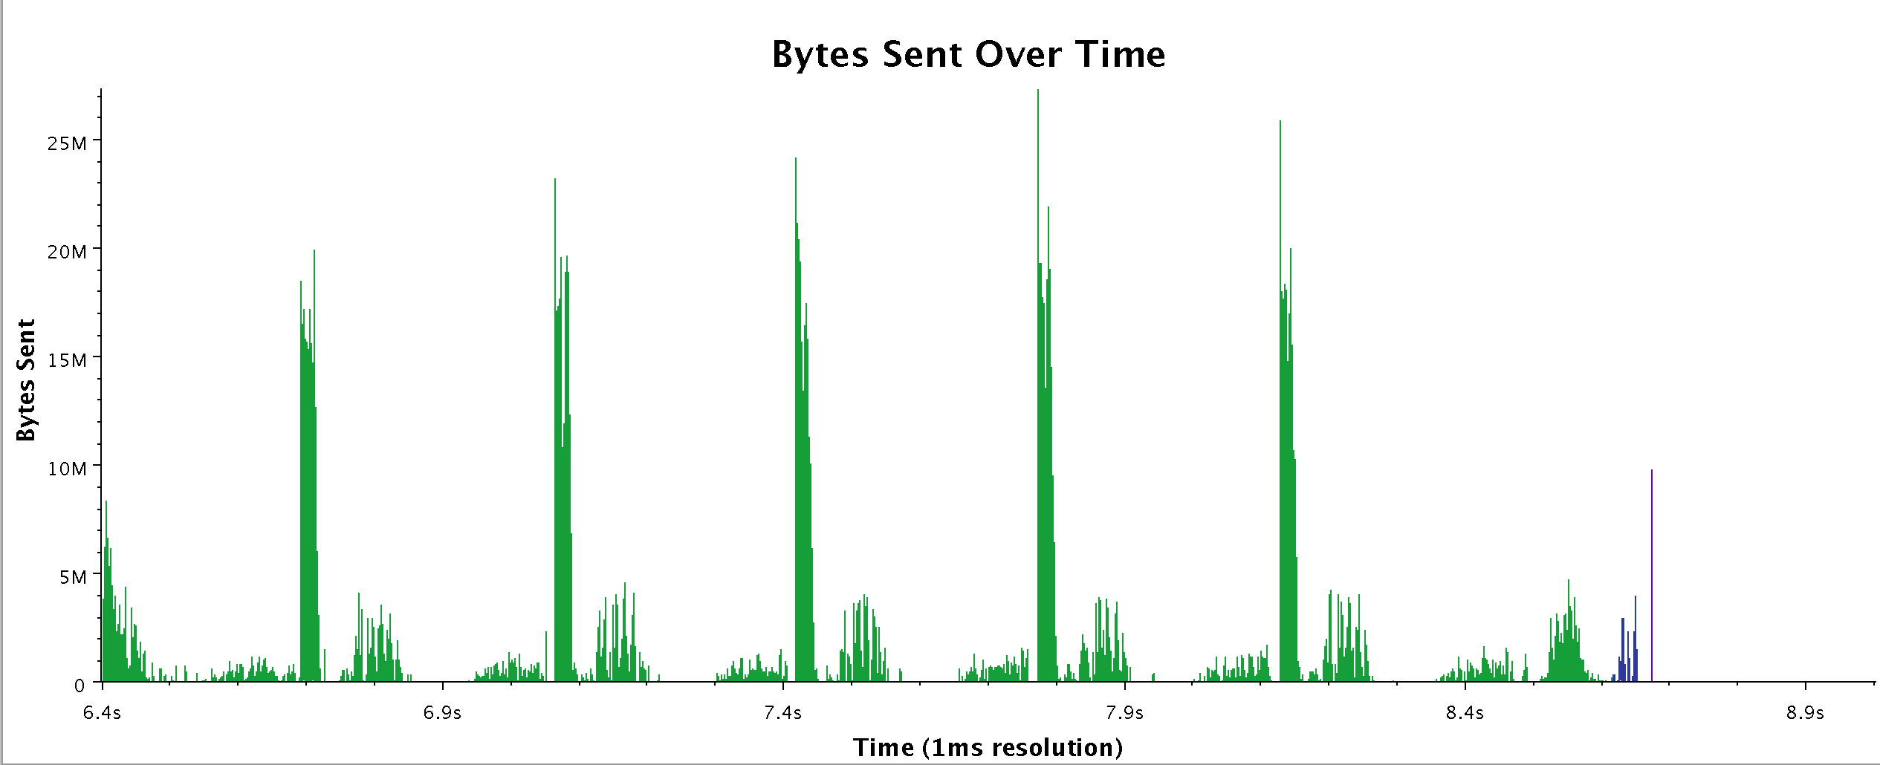
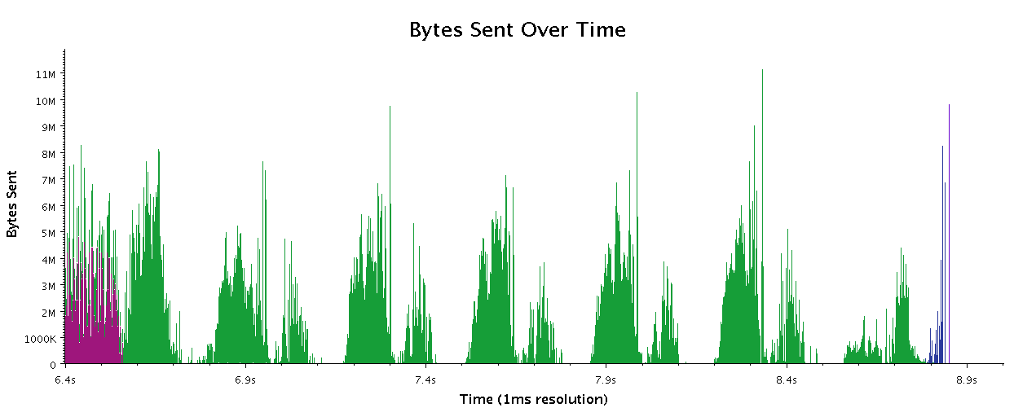
Recent data from Chombo
Work by Phil Miller
Chombo with reductions
Chombo on Charm (experimental)

Slide 20
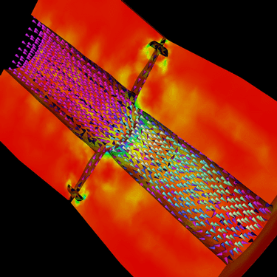
Decomposition Independent of num-nodes
Rocket simulation example under traditional MPI
With migratable-objects:
  Benefit: load balance, communication optimizations, modularity
Solid
Solid
. . .
Solid
Fluid
Fluid
Fluid
1 2 P
Solid₁
Solid₂
Solid₃
. . .
Solid_{n}
Fluid₁
Fluid₂
. . .
Fluid_{m}
Notes:
20
In traditional MPI paradigm. The number of partitions of both modules is typically equal to the number of processor P
And although the i’th elements of fluid module and solid module are not connected geometrically in the simulation, they are glued together on the I’th processor.
Under Charm++/AMPI framework, the two modules each get their own set of parallel objects. And the size of the arrays are not restricted or related.
The benefit of this is performance optimizations and better modularity.
Problem: due to the asynchronous method invocation, the flow of control is buried deep into the object code

Slide 21
Compositionality
It is important to support parallel composition
  For multi-module, multi-physics, multi-paradigm applications…
What I mean by parallel composition
  B || C where B, C are independently developed modules
  B is parallel module by itself, and so is C
  Programmers who wrote B were unaware of C
  No dependency between B and C
This is not supported well by MPI
  Developers support it by breaking abstraction boundaries
    E.g., wildcard recvs in module A to process messages for module B
  Nor by OpenMP implementations:

Slide 22
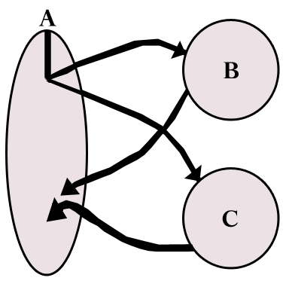
Without message-driven execution (and virtualization), you get either:
Space-division
B
C
Time
Notes:
Replace “scanned” diagram on the left with a better one, in all the slides that use this.

Slide 23
OR: Sequentialization
B
C
Time

Slide 24
Parallel Composition: A1; (B || C ); A2
  Recall: Different modules, written in different languages/paradigms, can overlap in time and on processors, without programmer having to worry about this explicitly

Slide 25
AMPI: Adaptive MPI
Each MPI process is implemented as a user-level thread
Threads are light-weight and migratable
  <1 microsecond context switch time, potentially >100k threads per core
Each thread is embedded in a Charm++ object (chare)
In both Charm++ and AMPI, we needed to make the threads migratable across nodes!
Accomplished using “isomalloc” idea from PM2 project in France.
Reserve Virtual memory for each thread’s stack on ALL nodes
Work with XPACC PSAAP center, led by Sam White, has extended functionality significantly
MPI processes
Virtual Processors (user-level migratable threads)
Real Processors

Slide 26
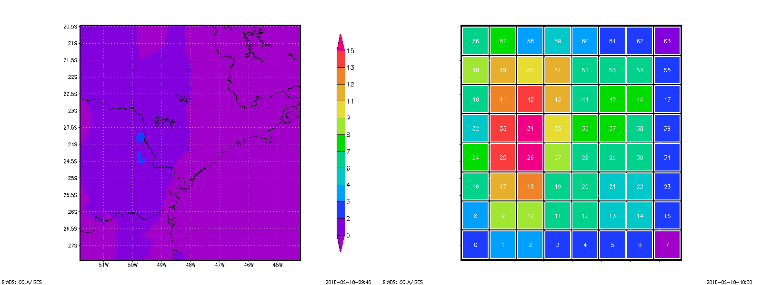
Grainsize: Weather Forecasting in BRAMS
Brams: Brazillian weather code (based on RAMS)
AMPI version (Eduardo Rodrigues, with Mendes, J. Panetta, ..)
Instead of using 64 work units on 64 cores, used 1024 on 64

Slide 27
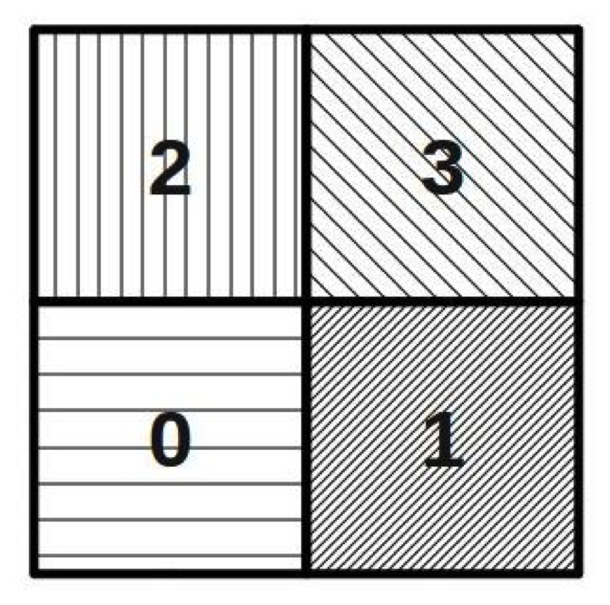
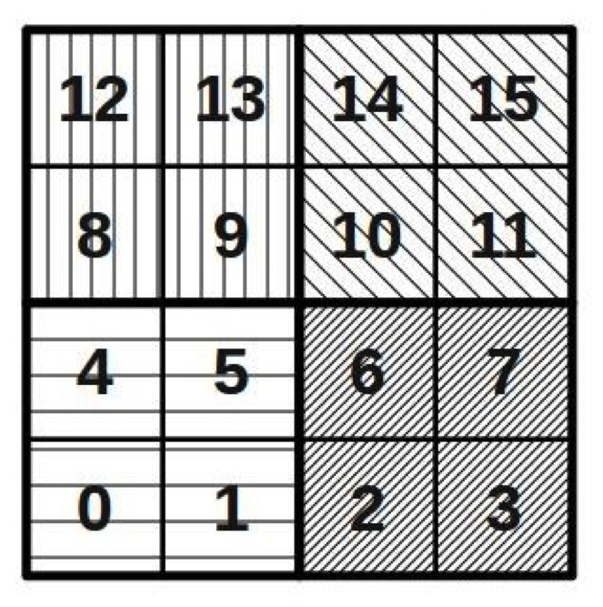
Basic Virtualization of BRAMS

Slide 28
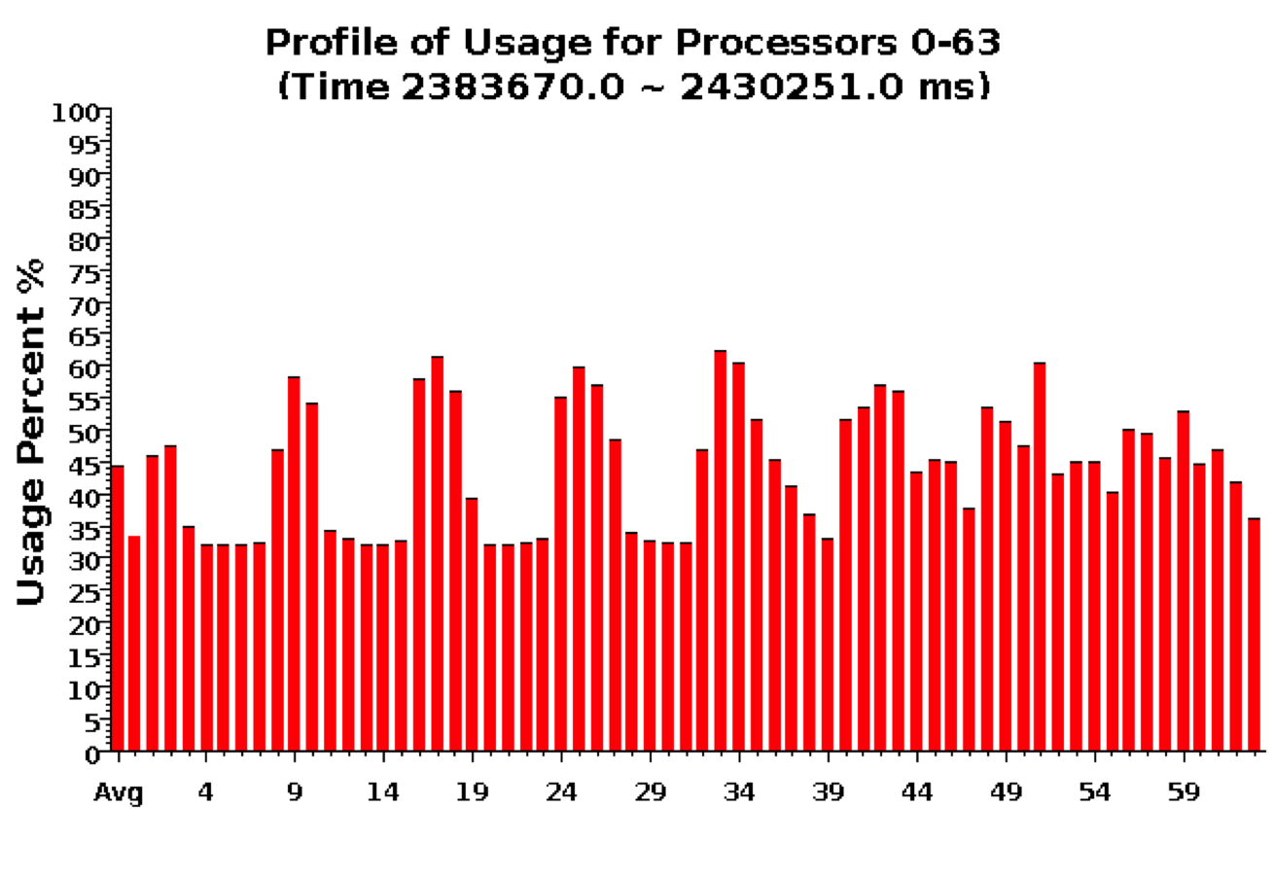
Baseline: 64 objects on 64 processors

Slide 29
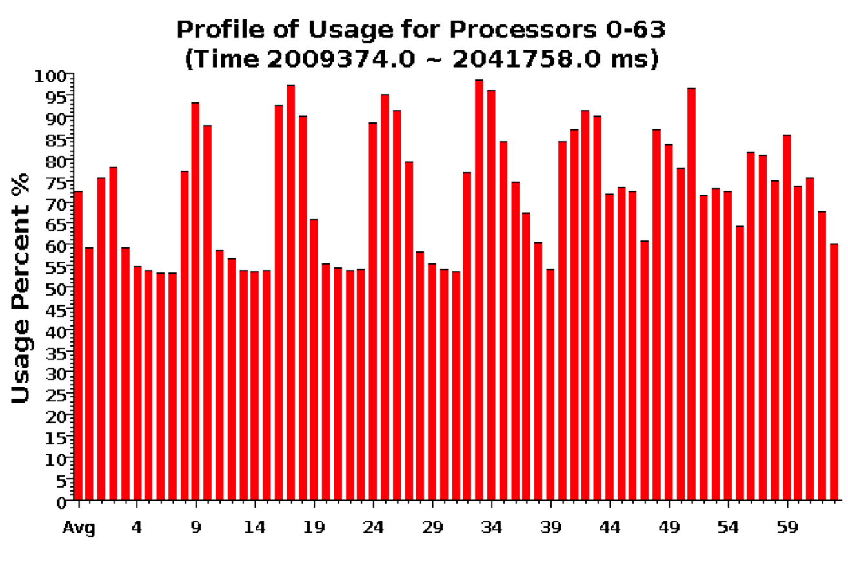
Over-decomposition: 1024 objects on 64 processors
Benefits from communication/computation overlap

Slide 30
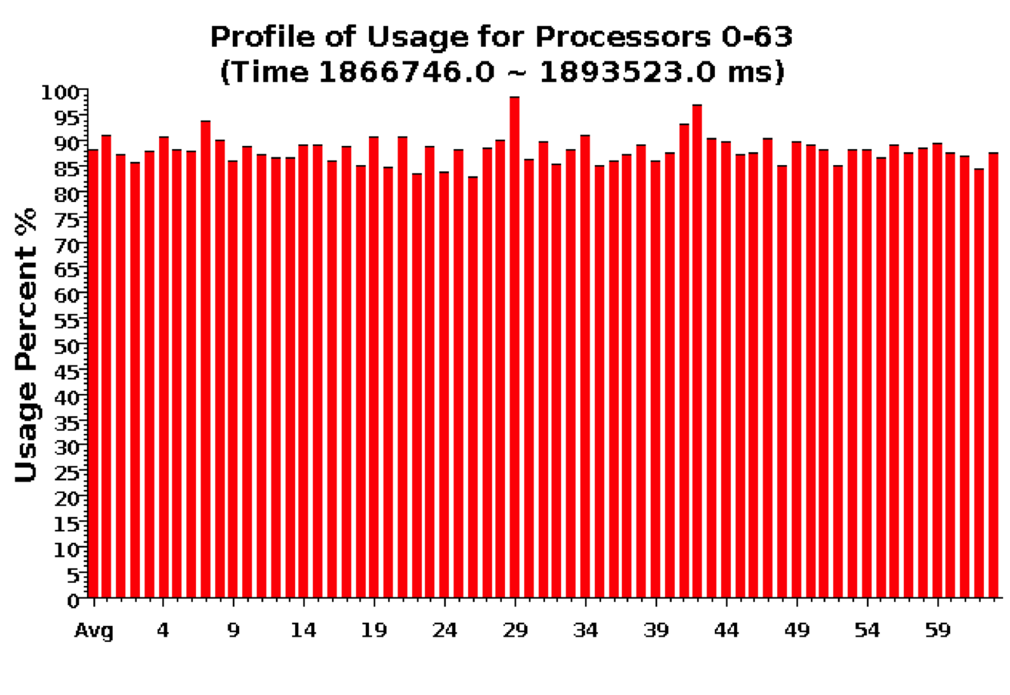
With Load Balancing: 1024 objects on 64 processors
No overdecomp (64 threads): 4988 sec
Overdecomp into 1024 threads: 3713 sec
Load balancing (1024 threads): 3367 sec

Slide 31
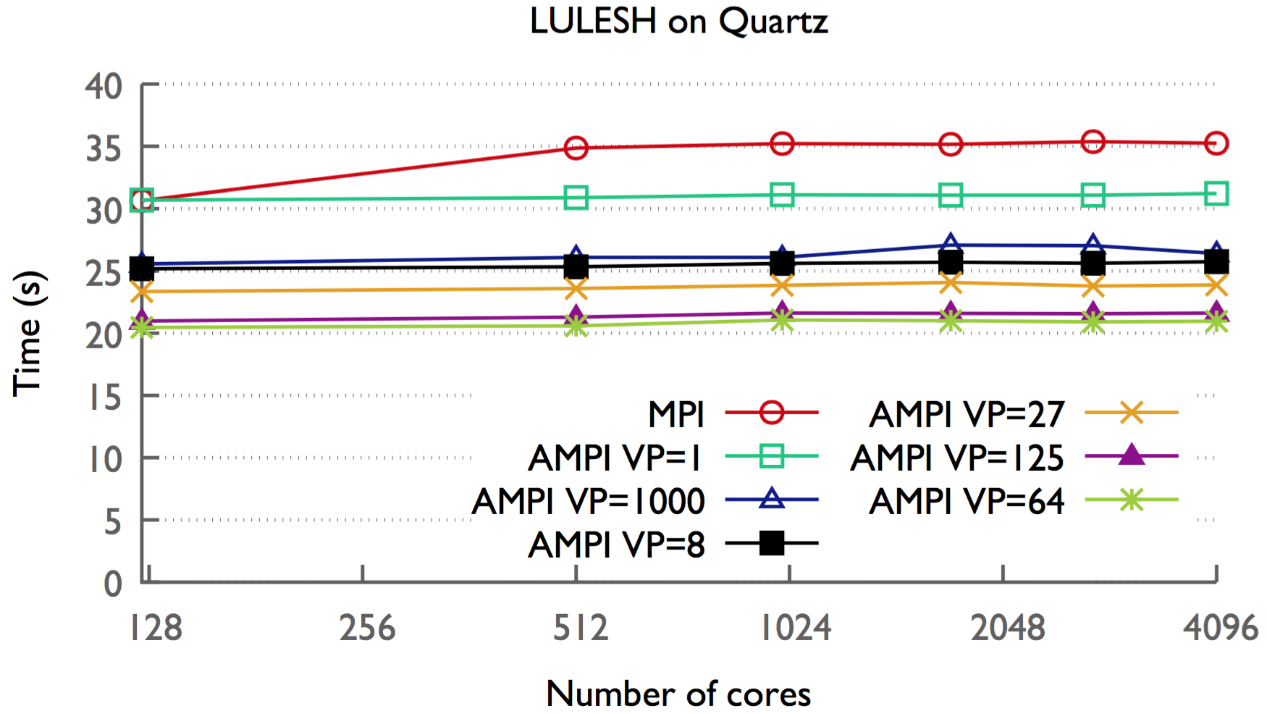
AMPI
Recent work with LLNL: Abhinav Bhatele & Nikhil Jain

Slide 32
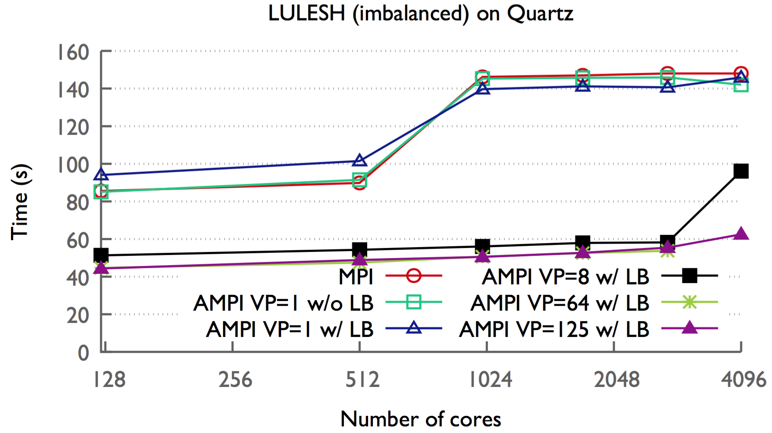
AMPI

Slide 33
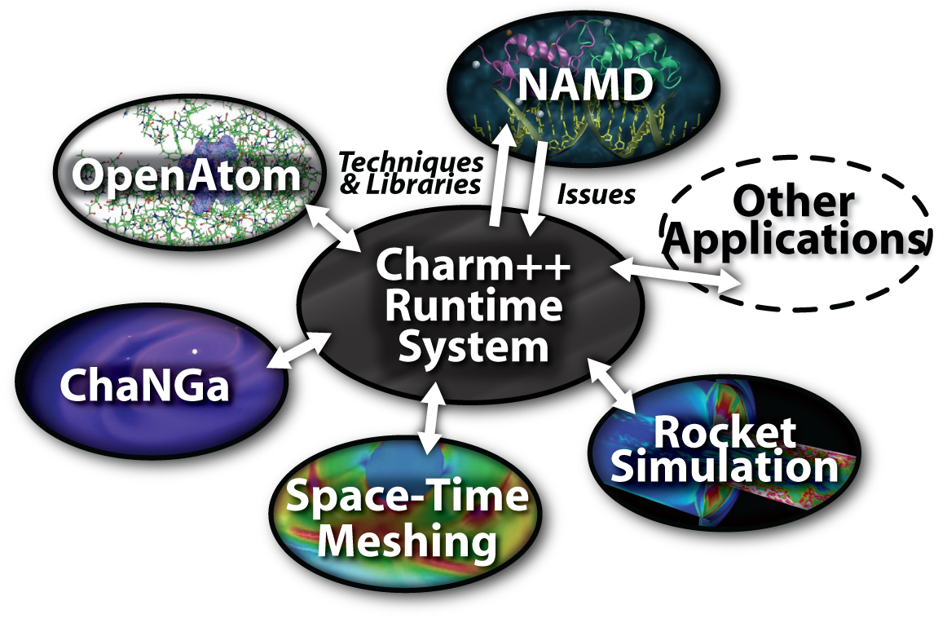
Charm++ and CSE Applications
Well-known Biophysics molecular simulations App
Gordon Bell Award, 2002
Nano-Materials..
Synergy
Enabling CS technology of parallel objects and intelligent runtime systems has led to several CSE collaborative applications
Computational Astronomy

Slide 34
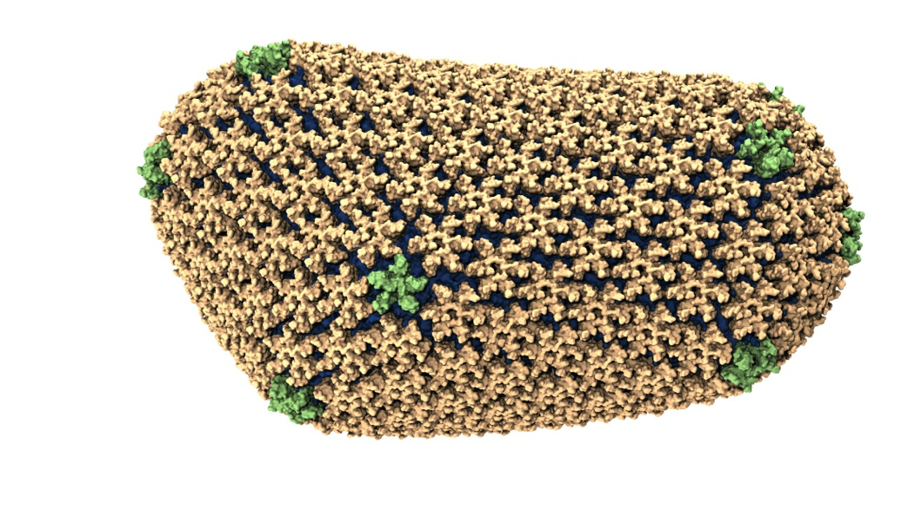
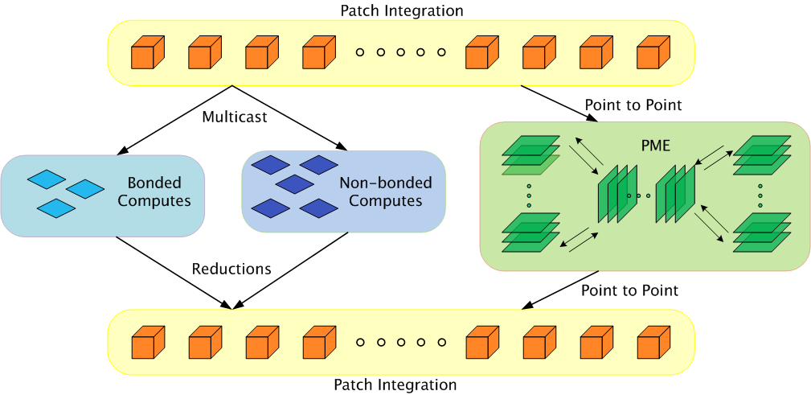
NAMD: Biomolecular Simulations
Collaboration with K. Schulten,..
With over 75,000 registered users
Scaled to most top US supercomputers
In production use on supercomputers, clusters and desktops
Gordon Bell award in 2002
Recent success: Determination of the structure of HIV capsid by researchers including Prof Schulten

Slide 35
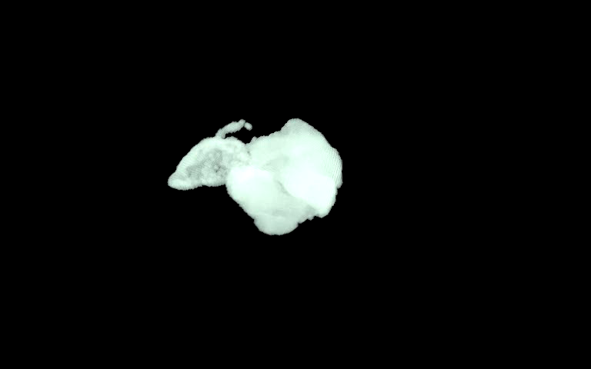
ChaNGa: Parallel Gravity
Evolution of Universe and Galaxy Formation
Collaborative project (NSF)
  with Tom Quinn, Univ. of Washington
Gravity, gas dynamics
Barnes-Hut tree codes
  Oct tree is natural decomp
  Geometry has better aspect ratios, so you “open” up fewer nodes
  But is not used because it leads to bad load balance
  Assumption: one-to-one map between sub-trees and PEs
  Binary trees are considered better load balanced
  With Charm++: Use Oct-Tree, and let Charm++ map subtrees to processors

Slide 36
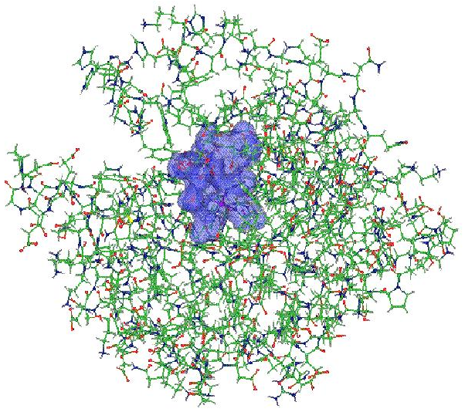
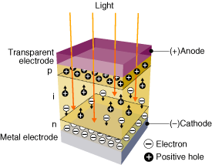
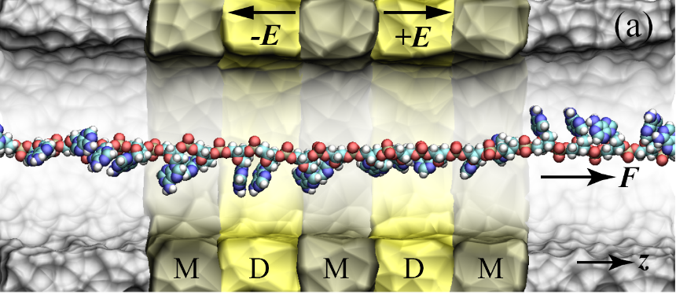
OpenAtom: On the fly ab initio molecular dynamics on the ground state surface with instantaneous GW-BSE level spectra
PIs: G.J. Martyna, IBM; S. Ismail-Beigi, Yale; L. Kale, UIUC;
Team: Q. Li, IBM, M. Kim, Yale; S. Mandal, Yale;
E. Bohm, UIUC; N. Jain, UIUC; M. Robson, UIUC;
E. Mikida, UIUC; P. Jindal, UIUC; T. Wicky, UIUC.
Light in
1

Slide 37
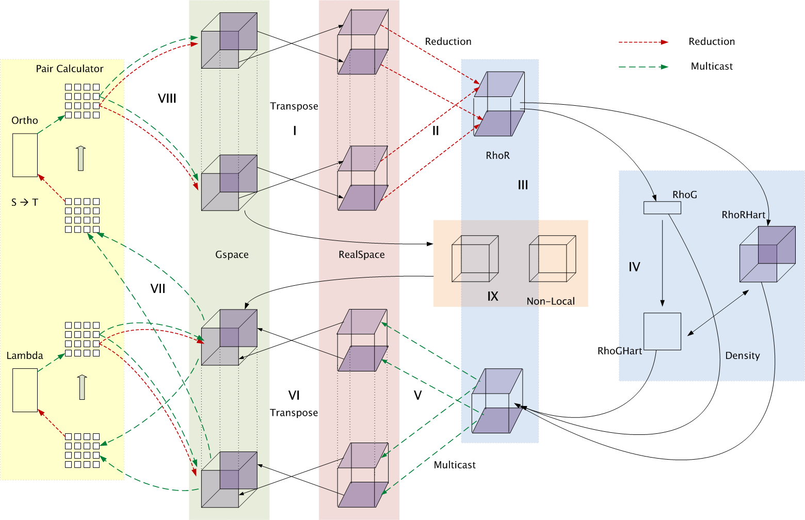
Decomposition and Computation Flow

Slide 38
Production Applications
Application | Domain | Previous parallelization | Scale
NAMD | Classical MD | PVM | 500k
ChaNGa | N-body gravity & SPH | MPI | 500k
EpiSimdemics | Agent-based epidemiology | MPI | 500k
OpenAtom | Electronic Structure | MPI | 128k
Spectre | Relativistic MHD |  | 100k
FreeON/SpAMM | Quantum Chemistry | OpenMP | 50k
Enzo-P/Cello | Astrophysics/Cosmology | MPI | 32k
ROSS | PDES | MPI | 16k
SDG | Elastodynamic fracture |  | 10k
ADHydro | Systems Hydrology |  | 1000
Disney ClothSim | Textile & rigid body dynamics | TBB | 768
Particle Tracking | Velocimetry reconstruction |  | 512
JetAlloc | Stochastic MIP optimization |  | 480

Slide 39
MiniApps
Available at: http://charmplusplus.org/miniApps/
Mini-App | Features | Machine | Max cores
AMR | Overdecomposition, Custom array index, Message priorities, Load Balancing, Checkpoint restart | BG/Q | 131,072
LeanMD | Overdecomposition, Load Balancing, Checkpoint restart, Power awareness | BG/P BG/Q | 131,072 32,768
Barnes-Hut (n-body) | Overdecomposition, Message priorities, Load Balancing | Blue Waters | 16,384
LULESH 2.02 | AMPI, Over-decomposition, Load Balancing | Hopper | 8,000
PDES | Overdecomposition, Message priorities, TRAM | Stampede | 4,096

Slide 40
More MiniApps
Mini-App | Features | Machine | Max cores
1D FFT | Interoperable with MPI | BG/P BG/Q | 65,536 16,384
Random Access | TRAM | BG/P BG/Q | 131,072 16,384
Dense LU | SDAG | XT5 | 8,192
Sparse Triangular Solver | SDAG | BG/P | 512
GTC | SDAG | BG/Q | 1,024
SPH |  | Blue Waters | -

Slide 41
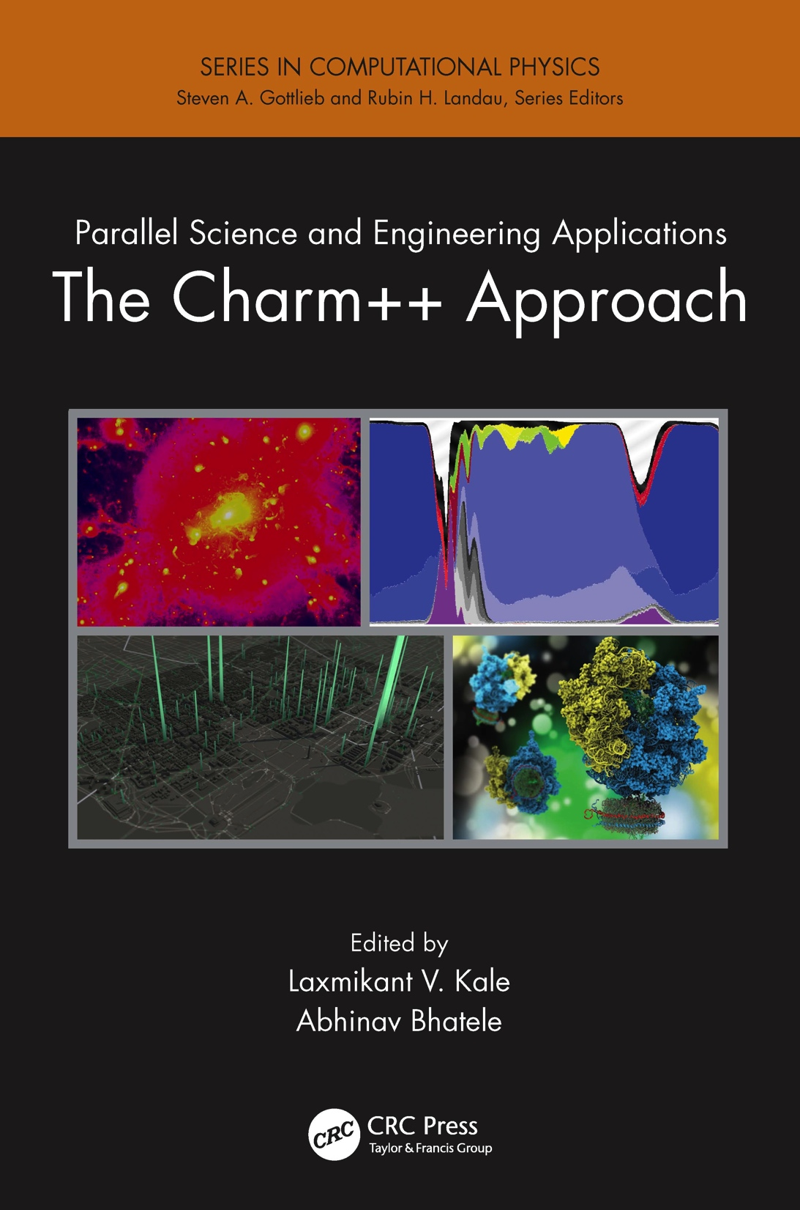
A recently published book
surveys seven major applications developed using Charm++
More info on Charm++:
http://charm.cs.illinois.edu
Including the miniApps

Slide 42
Relevance to Exascale
Intelligent, introspective, Adaptive Runtime Systems, developed for handling application’s dynamic variability, already have features that can deal with challenges posed by exascale hardware

Slide 43
Fault Tolerance in Charm++/AMPI
Four approaches available:
  Disk-based checkpoint/restart
  In-memory double checkpoint w auto. restart
  Proactive object migration
  Message-logging: scalable fault tolerance
Common Features:
  Easy checkpoint: migrate-to-disk
  Based on dynamic runtime capabilities
  Use of object-migration
  Can be used in concert with load-balancing schemes
Notes:
43

Slide 44
Saving Cooling Energy
Easy: increase A/C setting
  But: some cores may get too hot
So, reduce frequency if temperature is high (DVFS)
  Independently for each chip
But, this creates a load imbalance!
No problem, we can handle that:
  Migrate objects away from the slowed-down processors
  Balance load using an existing strategy
  Strategies take speed of processors into account
Implemented in experimental version
  SC 2011 paper, IEEE TC paper
Several new power/energy-related strategies
  PASA ‘12: Exploiting differential sensitivities of code segments to frequency change

Slide 45
PARM:Power Aware Resource Manager
Charm++ RTS facilitates malleable jobs
PARM can improve throughput under a fixed power budget using:
  overprovisioning (adding more nodes than conventional data center)
  RAPL (capping power consumption of nodes)
  Job malleability and moldability

Slide 46
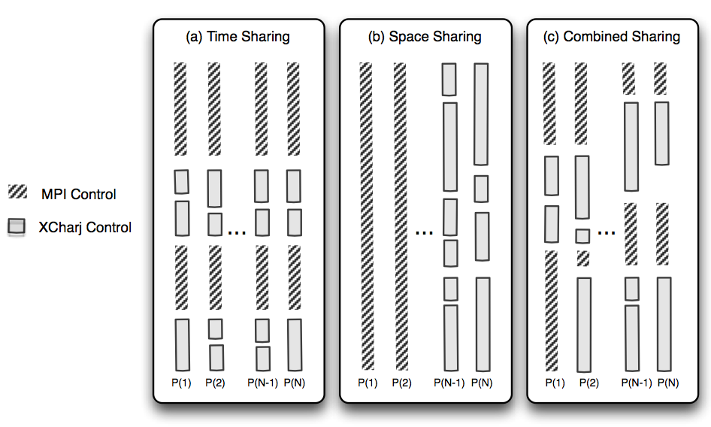
Charm++ interoperates with MPI
So, you can write one module in Charm++, while keeping the rest in MPI
Charm++ Control

Slide 47
Integration of Loop Parallelism
  Used for transient load balancing within a node
Mechanisms:
  Charm++’s old CkLoop construct
  New integration with OpenMP (gomp, and now llvm)
  BSC’s OMPSS integration is orthogonal
    Uses BSC’s scheduler
RTS splits a loop into Charm++ messages
  Pushed into each local work stealing queue
    where idle threads within the same node can steal tasks

Slide 48
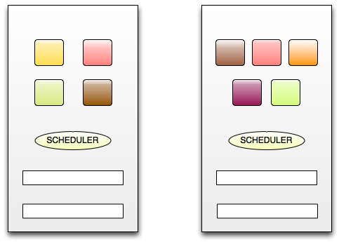



Core0
Core1
Message Queue
Message Queue
Task Queue
Task Queue
Integrated RTS
(Using Charm++ construct or OpenMP pragmas)
for ( i = 0; i < n ; i++) {
…
}

Slide 49
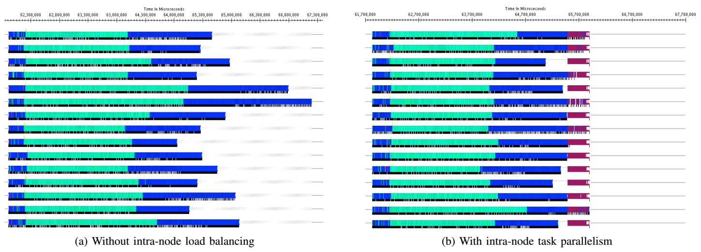
Projection of ChaNGa with cosmo25 on Blue Waters, Cray XE6
(128K cores)

Slide 50
Projection of ChaNGa with cosmo25 on Blue Waters, Cray XE6
(128K cores)

Slide 51
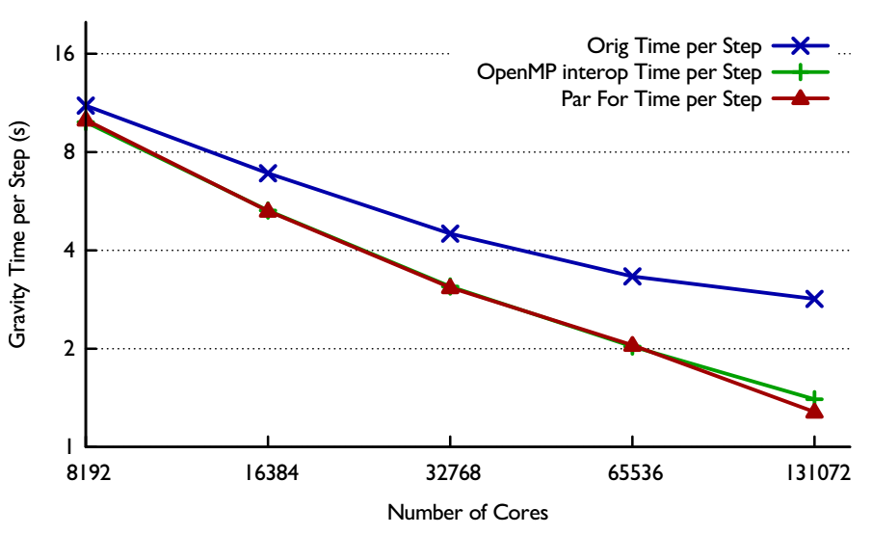
ChaNGa with cosmo25 on Blue Waters, Cray XE6
>>
2.84
2.21x speed up
1.40
1.28
Notes:
This graph shows how much our fine-grained parallelism improve the performance of ChanGa. The x axis represents the number of cores used for this experiment.
And the y axis shows the gravity time per step of each execution in seconds.
From 8K cores, our work help improve the performance of ChaNGa significantly over the Original Charm++. In 128K cores, our parallel construct achieves 2.21x speed up over the Original Charm++ in this experiment.

Slide 52
Recent Developments: Charmworks, Inc.
Charm++ is now a commercially supported system
  Charmworks, Inc.
  Supported by SBIR and small set of initial customers
Non profit use (academia, US Govt. Labs, etc.) remains free
We are bringing improvements made by Charmworks into the University version (no forking of code)
Specific improvements have included:
  Better handling of errors
  Robustness and ease of use improvements

Slide 53
Recent Features and Optimizations
Optimizations for fine-grained applications
  NAMD at extreme scale, Graph Algorithms, Parallel Discrete Event Simuln
One-sided communication
  Incorporation in the runtime
  New primitives for accessing them explicitly
OpenMP Integration
Better out-of-the-box performance
  Better defaults
  On-line learning
  This includes ongoing work (At Charmworks and researchy aspects at UIUC)
    Meta-balancer, starting configuration parameters, SMT threads use, communication threads use,

Slide 54
Summary
Charm++ embodies an adaptive, introspective runtime system
Many applications have been developed using it
  NAMD, ChaNGa, Episimdemics, OpenAtom, …
  Many miniApps, and third-party apps
Adaptivity developed for apps is useful for addressing exascale challenges
  Resilience, power/temperature optimizations, ..
More Info: http://charm.cs.illinois.edu/ (including the miniApps)
Overdecomposition
Asynchrony
Migratability

