Slide 1
Sandboxing Untrusted JavaScript
Ankur Taly
Thesis Defense
Advisor: Prof. John C. Mitchell
Ankur Taly

Slide 2
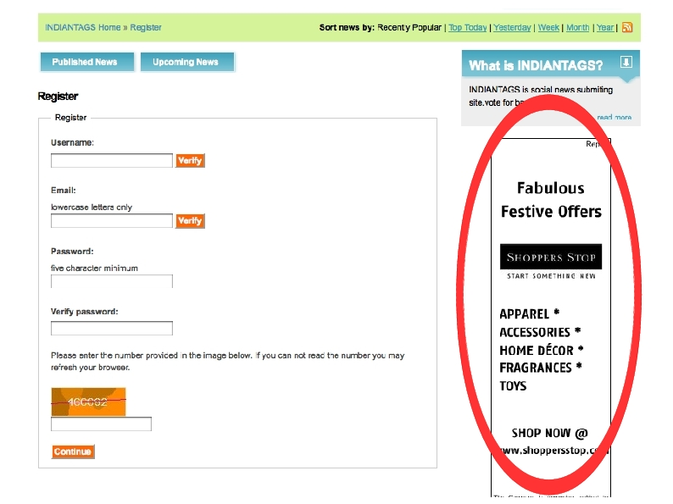
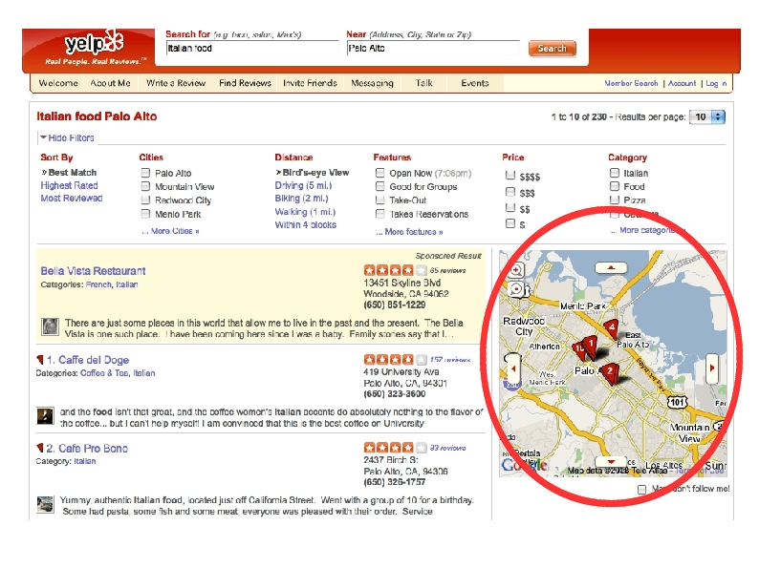
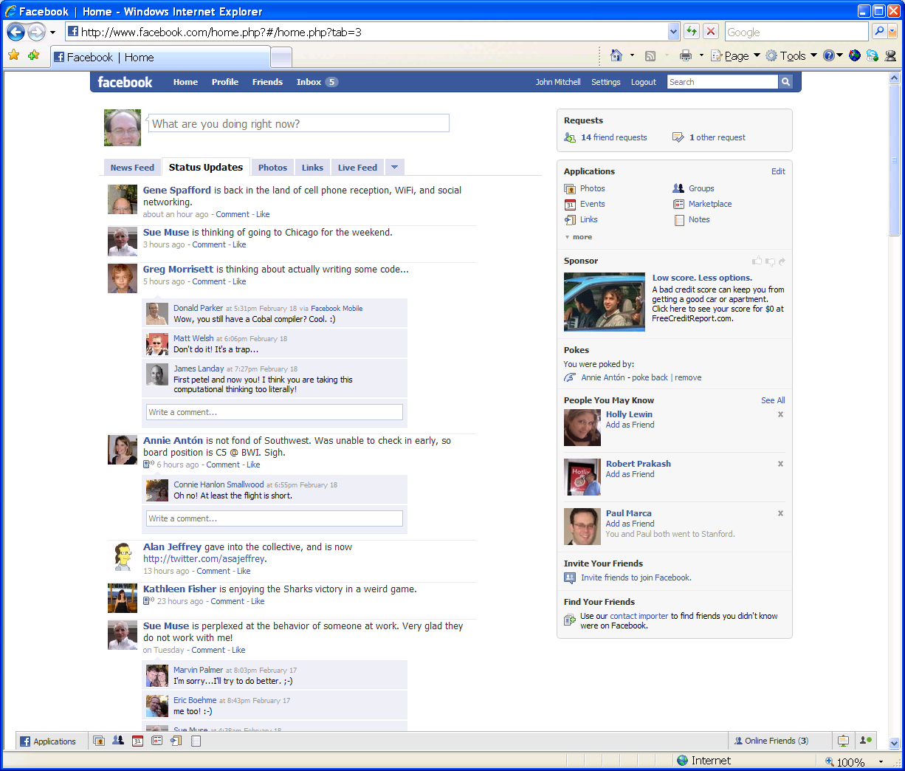
Web 2.0: Webpages with third-party content
Ads
Maps
Social-Networking Apps
Third-party content often contains executable JavaScript code (AJAX)
manipulates features of hosting page, reacts to user events, talks to servers
provides a rich user-experience
Third-party content is often untrusted
This Work: Study methods for safely embedding untrusted third-party JavaScript
Notes:
I am sure all of you have used web sites that have ads, map or social networking apps.
These are all examples of third-party content which websites embed
Very often such third-party content contains of executable Javascript content that reacts o user events, manipulates features of the hosting page, interacts with the server and thus provides a rich user experience.
This work is about developing methods

Slide 3
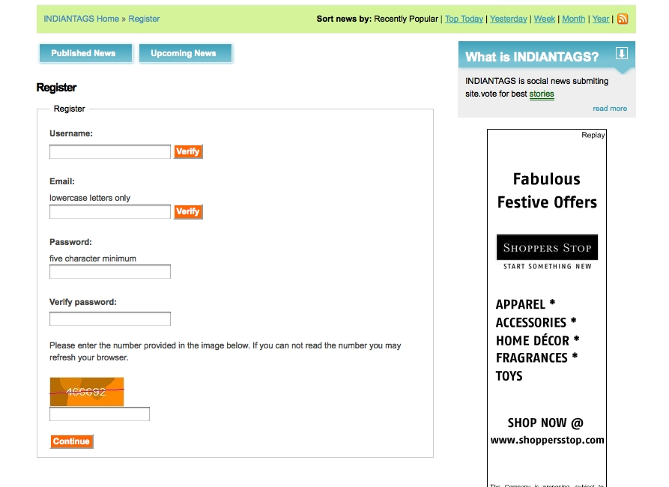
Third-party JavaScript: Security Threat
<script src=“https://adpublisher.com/ad1.js”></script>
<script src=“https://adpublisher.com/ad2.js”></script>
Read password using the DOM API
var c = document.getElementsByName(“password”)[0]
Document Object Model (DOM): programmatic interface for manipulating features of the page
Untrusted third-party JavaScript poses a threat to critical hosting page resources
Send it to evil location (not subject to same-origin policy)
<img src=``http::www.evil.com/info.jpg?_info_”>
Notes:
One way to emebed JavaScript is to use a script src – tag which means we simply take the Javascript code and append it to the page.
Here are two ads directly embedded in the page.
As I said before these scripts want to manipulate features of the page display fancy balls that bounce around on the screen etc.
How does they do that ?
They do that by acessing the document object model of the page, which is a programmatic interface to manipulating features of the page.
The DOM API provides methods for manipulating various elements of the page.
In particular it will provide access to all these form fields and so if the ad is malicious
it can steal the password and send it off to an evil location.
So untrusted third-party javaScript poses a threat to critical hosting page resources.

Slide 4
Third-party JavaScript: Security Threat
<script src=“https://adpublisher.com/ad1.js”></script>
<script src=“https://adpublisher.com/ad2.js”></script>
$1 Buy Now
Untrusted third-party JavaScript poses a threat to other third-party components
Attack the other ad: Change the price !
var a = document.getElementById(“sonyAd”)
a.innerHTML = “$1 Buy Now”;
Notes:
The Dom also provides acces to other third-party components of the page.
So the malcious ad here can use the DOM to obtain access to the other ad and then change its contents.
So untrusted third-party JavaScript poses a threat to other third-party components on the page.

Slide 5
JavaScript Sandboxing Problem
Problem: Design sandboxing mechanisms for untrusted JavaScript in order to:
protect critical resources belonging to the hosting page
protect resources belonging to other third-party components
Constraints: Solution MUST
not require browser modification
have provable guarantees
allow a practically useful subset of JavaScript
We want to be in this region
JS
Existing JS sandboxing(FBJS)
Notes:
Now I will state the JavaScript sandboxing problem. Whenever I use the word sandboxing it is in the abstract sense
As a mechanism to restrict.
The problem is to design a sandboxing mechanism for untrusted Javascript in order to protect critical hosting page resourcres
And also resources belonging to other third-party components.
There are two constraints here that I set for my self. No change to the browser because otherwise the solution would be difficult to deploy
And secondly the solution must have provable guarantees and hopefully by the end of this talk I will convince you why this second point is very important
Especially when dealing with Javascript.

Slide 6
Browser-Based Sandboxing: IFRAMES
Separate execution environment
IFrame
Third-party code
Hosting page
Third-party content server
PostMessage API (2009 onwards)
Rich abstractions can be built on top: [DeKeukelaere et al.], [Barth et al.]
Hosting page server
However, IFrames may NOT be the preferred option (especially back in 2008)
restricts content to a confined region of the screen
hosting page is still vulnerable to malware, frame navigation, CSRF, …
performance penalty in exposing a library across frame boundary
Analogy: Process-based Isolation in operating systems
Notes:
One way to solve this problem is to use the iframe mechanism that the browser provides. Here is how it works.
First load the hosting page. Then create an Iframe which is basically a sub-window in the page. Then load third-party code into this Iframe.
The browser guarantees that allJavascript in an Iframe runs in a separate execution environment and is isolated from the hosting page.
Since this is too restrictive and does notallow for any communication the browser also provide a postMessage API that can be used for communicating string across frame.
People have worked on this idea and developed rich abstractions on top of the postMessage API that allow for useful and controlled interaction between frames.
Since the past two years browsers also provide a postmessage

Slide 7
Our Approach: Language-Based Sandboxing
Statically analyze and rewrite third-party code
1
Sandboxed code
Hosting page
Third-party content server
Hosting page server
Restricted access
(determined by security policy)
What security policies must be enforced?
Notes:
Here is the idea is as follows.
As before load the hosting page first
Prefetch the third-party code at the hosting page server.
Statically analyze and rewrite it and then bring this rewritten code on the
page.
The static analysis and rewriting should be such that the rewritten code only has restricted access to the hosting page.
This static analysis and rewriting is what we call language-based sandboxing.
Now depending on the securty policy that we wish to enforce on the interaction between third-party code and the hosting page,
we will appropriately design the sandboxing mechanism.
This approach is followed Facebook FBJS, Yahoo AdSafe and Google Caja
Now in order to design language-based sandboxing the first question is what security policies must be enforced.
In order to answer this question we manually analyzed the implementation of FacebookFBJS, Adasfe and Caja.
Note that these sandboxing mechanisms do not come with any formal documentation of their security goals and therefore
We had to infer the policies from the respective implementations

Slide 8
Three Security Policies
Hosting Page Isolation
Inter-component Isolation
Mediated Access
Notes:
In thre next few slides I will define these policies and then define the sanboxing problems for each of them.

Slide 9
Hosting-Page Isolation
Language-based sandboxing
1
Sandboxed code
Security-critical
resources
Third-party content server
Hosting page
Hosting page server
e.g., document.cookie, document.location,…
Sandbox Design Problem: ensure that sandboxed code does not access a given set of security-critical resources
Notes:
Consider the language-based sandboxing setup. The hosting page may have certain security objects such
as the cookie, the location object etc which it want to completely isolate from untrusted code. So untrusted code must acess them whatsover.
This is called the hosting page isolation policy.
Thus given a set of security-critical resources, the Sandboxing problem is to design asandboxing mechanism to ensure that sanboxed code does not access any security critical resources.

Slide 10
Inter-Component Isolation
Language-based sandboxing
1
Alice
Bob
Security-critical
resources
Hosting page
Hosting page server
Third-party content servers
Sandbox Design Problem: ensure that all sandboxed components:
do not access any security-critical resources belonging to the hosting page
do not write to any heap location that the other component reads from
Notes:
Suppose we have two third-party components then the hosting page might want to isolate them from each other.
This is called the inter-component isolation policy.
Ensure sandboxed components do not ……
Note that this policy is weaker than non-interference and does not eliminate covert channels, they only eliminate communication via the heap.
(We went for this policy as this seemed to be the policy that FBJS was trying to enforce) – Also it is unclear if we want to have complete non-interference between ads.

Slide 11
Mediate Access: Setup
Statically analyze and rewrite third-party code
1
Sandboxed code
(only access the API)
API
Resources to protect
(entire DOM)
Third-party content server
Hosting page server
Security Goal: No direct access to security-critical resources
Motivated by Object Capabilities and the Principle of least privilege
Notes:
The previous two policies enforce isolation. So we can enforce complete isolation of the location object from untrusted code.
However this may be stronger than the desired policy.
We may be fine with third-party cod accessing the location object so long as it only sets the location to subdomains of google.com or microsoft.com.
We call this weaker policy mediated access policy.
All access to security critical resources must be mediated by the hosting page.
One way of enforcing mediated access
In order to do this the hosting page first creates an API that provides restricted access to the underlying resources, then prefetches third-party code, statically analyzes and rewritesi it so that it can only access the API.
So language-based sandboxing must restrict untrusted code to the API and the API must provide restricted or mediated access to the underlying resrouces.
The security goal is that no direct access to security critical resources.
CHANGE THIS SLIDE
A popular approach to solving this problem is API + language-based sandboxing
The main idea is as follows -> trusted hosting page loads firtst and creates an API that mediates access to all protected resources.
Then untrusted third-party code is first fetvhed into the hosting page server, and it is filtered and rewritten such that only
It can only access the API. This filtering and rewriting is the language-based sandboxing.
The main security property is that untrusted code must not directly come to hold any security-critical resource
This approach is used by FBJS, ADSAfe, Caja
Now the sandbox ensures that untrusted code can only access the API
The security of the approach relies on the API doing its job correctly
That is, it itself must not leak a reference to a critical resource.
This property is quite subtle to check especially for JS APIs.
We illustrate it using the following example.

Slide 12
Mediate Access: Setup
Statically analyze and rewrite third-party code
1
Sandboxed code
(only access the API)
3
2
1
API
Resources to protect
(entire DOM)
Third-party server
Hosting-page server
Notes:
The previous two policies enforce isolation. So we can enforce complete isolation of the location object from untrusted code.
However this may be stronger than the desired policy.
We may be fine with third-party cod accessing the location object so long as it only sets the location to subdomains of google.com or microsoft.com.
We call this weaker policy mediated access policy.
All access to security critical resources must be mediated by the hosting page.
One way of enforcing mediated access
In order to do this the hosting page first creates an API that provides restricted access to the underlying resources, then prefetches third-party code, statically analyzes and rewritesi it so that it can only access the API.
So language-based sandboxing must restrict untrusted code to the API and the API must provide restricted or mediated access to the underlying resrouces.
The security goal is that no direct access to security critical resources.
CHANGE THIS SLIDE
A popular approach to solving this problem is API + language-based sandboxing
The main idea is as follows -> trusted hosting page loads firtst and creates an API that mediates access to all protected resources.
Then untrusted third-party code is first fetvhed into the hosting page server, and it is filtered and rewritten such that only
It can only access the API. This filtering and rewriting is the language-based sandboxing.
The main security property is that untrusted code must not directly come to hold any security-critical resource
This approach is used by FBJS, ADSAfe, Caja
Now the sandbox ensures that untrusted code can only access the API
The security of the approach relies on the API doing its job correctly
That is, it itself must not leak a reference to a critical resource.
This property is quite subtle to check especially for JS APIs.
We illustrate it using the following example.

Slide 13
Inter-Component Isolation
Language-based sandboxing
1
Sandboxed code
(only access the API)
API
Resources to protect
(entire DOM)
Hosting page server
Third-party content servers
Sandbox Design Problem: ensure that all sandboxed components:
do not access any security-critical resources belonging to the hosting page
do not write to any heap location that the other component reads from
Notes:
Suppose we have two third-party components then the hosting page might want to isolate them from each other.
This is called the inter-component isolation policy.
Ensure sandboxed components do not ……
Note that this policy is weaker than non-interference and does not eliminate covert channels, they only eliminate communication via the heap.
(We went for this policy as this seemed to be the policy that FBJS was trying to enforce) – Also it is unclear if we want to have complete non-interference between ads.

Slide 14
Mediated Access: Problems
Sandbox Design: ensure that sandboxed code obtains access to ANY protected resource ONLY via the API
Sandboxed code
(only access the API)
API
Resources to protect
(entire DOM)
API Confinement: verify that sandboxed code cannot use the API to obtain direct access to a security-critical resource
Notes:
Change the browser picture on this slide

Slide 15
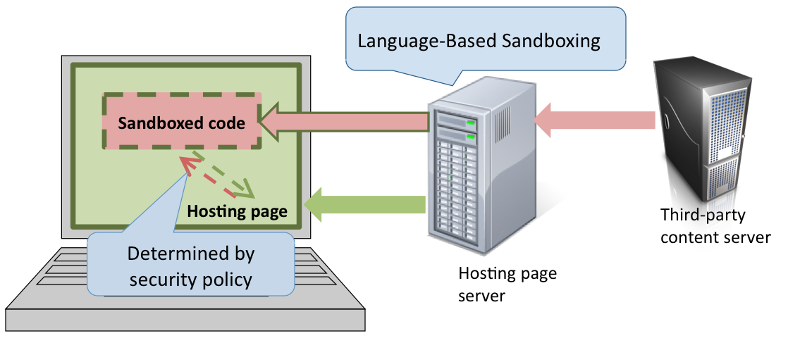
Problem: Summary
Setup:
Policies:
Hosting Page Isolation
Inter-Component Isolation
Mediated Access
Language: standardized JavaScript
ECMA-262 3rd edition (ES3) - Dec’99
ECMA-262 5th edition (ES5) - Dec’09
has a strict mode (ES5-strict)
Techniques:
Language Semantics
Inlined Runtime Monitoring
Static Analysis
Object Capabilities
Notes:
Change the setup picture

Slide 16
Results
Mediated Access (ES5-strict)
Attacks found by us
Automated Analysis of Security-Critical JavaScript APIs [Oakland’11]. Automated Tool: ENCAP
Confinement attacks on the FBJS₁₀ and ADSafe₁₀ DOM APIs
Inter-Component Isolation (ES3)
2011
Object Capabilities and Isolation of Untrusted Web Applications [Oakland’10]
Inter-component attack on the FBJS₁₀ sandbox
Hosting-Page Isolation (ES3)
2010
Isolating JavaScript with Filtering Rewriting and Wrapping [ESORICS’09]
Hosting page attack on the FBJS₀₉ sandbox
Language-Based Isolation of Untrusted JavaScript[CSF’09]
2009
Hosting page attack on the FBJS₀₈ and ADSafe₀₈ sandboxes
Formal framework for JavaScript (ES3)
An Operational Semantics for JavaScript [APLAS’08]
2008
Notes:
Above semantics write mathematical framework
Remove ES3 etc
Put an outline right after this

Slide 17
Hosting Page Isolation

Slide 18
Hosting Page Isolation
Sandboxed code
Sandbox Design Problem: ensure that sandboxed code does not access a given set of security-critical resources
Security-critical
resources
Hosting page

Slide 19
Hosting Page Isolation: Plan
Operational Semantics for JavaScript (ES3)
Sandboxing technique
Comparison with FBJS

Slide 20
Key Features of JavaScript (ES3)
Developed by Brendan Eich in 1995, inspired by Self
First-class functions, hash table like objects
var o = {}; o.foo = function(){}; o[“foo”]();
Prototype-based inheritance, built-in prototype objects provided by the environment, e.g., Object.prototype
Dynamic code generation
eval(“x = x + 1;”)
Scopes as first-class objects
var o = {x:1}; with(o){x = 2}; // sets o.x to 2!
Peculiarities:
very few (run-time) type errors:
x = “a” + {} ; // runs perfectly!
unrolling of while loops is NOT semantics preserving
while(e){ s } if(e){ s; while(e){s} }
≠

Slide 21
Operational Semantics for JavaScript (ES3)
Developing a semantics for a real language is hard!
sheer size
further, JavaScript is full of surprises!
We developed a small-step operational semantics [Plotkin]
based on 3rd edition of the ECMA-262 specification
does not model the DOM
very long (70 pages in ASCII), took 6 man-months
spotted lots of descripencies across browsers
Proved sanity-check properties
Theorem 1: Execution of well-formed terms never gets stuck
Theorem 2: Execution of a term only depends on the reachable heap locations
Related work using our semantics
[Smith et al., POPL’12] , [Fredrikson et al., 2012]
Notes:
We developed an operatonal semantics for this language, firstly to setup a mathemtical framework for reasoning about JavaScript
And also partly to just understand the language.
Dveloping an operational semantics for a real language is quite hard. We don’t want a toy semantics we want the whole thing.
We develeped a small –step style semantics by adapating Plotkin’s seminal work to JavaScript.
Its based on the 3rd edition of the spec, we don’t model the DOM.
As I said it is the whole thing so it is fairly long and took us 6 man months
We obtained lots fo valuable insights, potted discripensies across browsers
And proved a basica sanity check theorem that execution of a term only depends on the set of reachable heap locaitons

Slide 22
Hosting Page Isolation: Plan
Operational Semantics for JavaScript (ES3)
Sandboxing technique
Comparison with FBJS
Sandbox Design Problem: ensure that sandboxed code does not access a given set of security-critical resources

Slide 23
Sandbox Design Problem
Construct a blacklist B of global variables from which security-critical objects are reachable, e.g., B = { “window”, “document”, …}
Sandbox Design Problem: ensure that sandboxed code does not access any global variables from a given blacklist B
rew(s)
does not access global variables from B
Filter & Rewriter
s
Third-party
Simple Approach: do a static scope analysis to determine which identifiers resolve to global variables

Slide 24
What global variables does a given JS program access ?
var x = 42;
function foo(){
var x = 21;
<some code>
return x;}
foo();
Can foo access the global variable x?
YES!! delete the local declaration of x
OR, get hold of the global scope object and access its fields
delete x;
x = this.x;
eval(“x = this.x”);
dynamically generate this code!
// returns 42
Also: with, try-catch
OK, let’s not do a scope analysis ☹. We are stuck with:
every identifier or property lookup could potentially resolve to a
global variable
Notes:
OK so for example we have this program , what are the global vars that it can access.
Can it access x.
Unfortuantely yes because you can delete variables form JS
Ahh lets remove delete from the language
OK so then you can use the keyword this to directly get hold of the global scope and read properties off it.
Fine I will disallow this as well. Then you will dynamically generate this code
And then you can trick me with with , try –catch and other fancy scope manipulatiion mechanisms.
OK I give up. I will not do a scope analysis
I am stuck with fact that any identifier that you have is a global variable
And all global vars are accessibel via the global object

Slide 25
Sandbox Design Problem: Restatement
(Conservative) Reformulation: ensure that sandboxed code does NOT access any identifiers or properties named in blacklist B
rew(s)
does not access any identifiers or properties named in B
Filter & Rewriter
s
Third-party
Approach:
Disallow dynamic code generation
Filter or rewrite all identifier and property access mechanisms
Notes:
So I conservatively reformulate the sandboxing problem to say that sandboxed code must not access any identifier or property name from the blacklist B.
Be it a local variable or a global variable, if it in the blacklist then you cannot access it.
In order to solve this problem, our approach has two steps:
First we must disallow all forms of dynamic code generation. This is because if there is dynamic code generation, then that provides a channel for generating code at runtime that escapes our sandboxing mechanism.
The second step is to then identify all identifier and property lookup channels and impos a blacklisting check on them,

Slide 26
Enforcing the Blacklist
Dynamic Code Generation: eval and Function constructor
can be accessed via properties “eval”, “Function”, “constructor”
add these to the blacklist B
What are the identifier and property access mechanisms in JS ?
Identifiers x
Identifier Filter: filter all terms that have an identifier x ∈ B
Dot e.x
Dot Filter: filter all terms that have a sub-term e.x with x ∈ B
Dynamic Property lookup e1[e2]
IDX Rewriting: rewrite e1[e2] → e1[IDX(e2)]
also used by FBJS
Notes:
The first is the standard identifier mechanisms which is that you can access identifiers by simply naming them in the code.
We therefore filter out all terms that use a blacklisted identifier name.
The second is the Dot mechanism so you can access property names by using the expressed e.x where expression e evaluates to an object x is a property name.
Again we filter out all terms that have a subterm e.x such that x is blacklsited.
Property names can be accessed by the standard e.x mechanism where e is an object and x is a property name. Again we impose a filter which discards all programs
That contain a subterm e.x such that x is balcklisted.
Finally property names can also be generated dynamically. Remember objects are hash tables in JavaScript so object properties

Slide 27
Attack on FBJS₀₉ IDX Rewriting
Semantics of $FBJS.IDX(e)
evaluate e
convert (1) to a string
if (2) is blacklisted return “bad”, else return (1)
TOCTTOU attack (Safari): Pass an object that returns different values on consecutive string conversions
var o = GET_SCOPE;
o.toString = function(){
this.toString = function(){return “eval”;};
return “foo”};
var f = function(){};
f[o](‘alert(“hacked”)’)();

Slide 28
Our IDX Rewriting
Blacklist all variable names beginning with “$”
IDX Initialization:
var $String = String;
var $Bl = {eval:true,...,constructor:true};
IDX Rewriting:
IDX(e) ≡ ($=e,
{toString:
function(){
return($=$String($),$Bl[$]?"bad":$)}
});
Semantics preserving for e1[e2] when e2 is not blacklisted

Slide 29
Evaluation
rew(s)
does not access any identifiers or properties named in B
Filter & Rewriter
s
Third-party
Define J_{safe}(B) as ES3 with Identifer and Dot filters applied
Define rew: J_{safe}(B) →J_{safe}(B) using IDX rewriting
Let H be the heap obtained by executing the IDX initialization code
Theorem [ESORICS’09]: For all terms t ∈ J_{safe}(B) , rew(t) when executed on heap H does not access any identifier or property name from B
Other Results
Mechanism for isolating the global scope object [ESORICS’09]
Semantics-preserving renaming technique for identifiers [CSF’09]

Slide 30
Hosting Page Isolation: Plan
Operational Semantics for JavaScript (ES3)
Sandboxing technique
Comparison with FBJS

Slide 31
Facebook FBJS
Rewrite FBJS
1
Rewritten app
FBJS app
Third-party application
server
Facebook
server
FBJS is a sublanguage of JavaScript designed for writing Facebook apps
Notes:
FBJS follows the language-based sandboxing paradigm.
Thirdparty applications are written in FBJS which is a subset of Javascript.
These FBJS applications are first fetched by the Facebook server which rewrites them and
Then embeds the reiwritten apps in profiles. Lets look at some of the restrictions enforced by the static subsetting and rewriting.

Slide 32
Comparison with FBJS
FBJS sandboxing mechanism (for Hosting Page Isolation)
Blacklists critical identifiers and property names
IDX like check on dynamically generated properties
Disallows with, eval, Function
Our technique: inspired by FBJS , But:
Systematically designed
IDX check is semantics preserving, overall more expressive than FBJS
backed by rigorous proof of correctness
Impact on FBJS: found 4 different exploitable vulnerabilities
built “malicious apps” that could reach the DOM
reported them along with fixes that were adopted promptly
Limitation: our guarantees hold only for JavaScript (ES3) as standardized
Take Away: Formal semantics are immensely useful in both designing and analyzing sandboxing mechanisms

Slide 33
Mediated Access

Slide 34
Mediated Access: Problems
Sandbox Design: ensure that sandboxed code obtains access to ANY protected resource ONLY via the API
Sandboxed code
(only access the API)
API
Resources to protect
(entire DOM)
API Confinement: verify that sandboxed code cannot use the API to obtain direct access to a security-critical resource
Notes:
Change the browser picture on this slide

Slide 35
Mediated Access: Plan
ES5-strict and Secure ECMAScript (SES)
Sandboxing technique
Confinement analysis technique
Application: Yahoo! ADSafe

Slide 36
Enforcing mediated access is challenging for ES3
No lexical scoping
Ambient access to global scope object
Lack of closure-based encapsulation (in implementations)
Mutable built-ins
Dynamic Code Generation (eval)
Designing and analyzing mediating APIs is a nightmare!

Slide 37
The ES5-strict language
ES5-strict = ES3 with the following restrictions
Restriction (relative to ES3) | Rationale
No delete on variable names
No prototypes for scope objects
No with
No this coercion
Safe built-in functions
No .caller, .callee on arguments object
No .caller, .arguments on function objects
No arguments and formal parameters aliasing
Lexical scoping
No ambient access to Global object
Closure-based encapsulation
Notes:
Standardized JS is an evolving language with the 5th edition being the most recent standard
The 5th edition also has a strict mode which brings in standard properties like lexical scoping
Closure based encapsulation and isolation of global objects to the language.
These are very standard properties which were absent in ES3. For instance in
ES3 if you call a function then the function could a pointer into your activation record which basically
break closure based encapsulation. This is disallowed in ES5-strict

Slide 38
Our sub-language Secure ECMAScript (SES)
SES = ES5-strict with two more restrictions:
Immutable built-in objects (e.g., Object.prototype)
Only scope-bounded eval
Remarks
Practical to implement within ES5-strict
Under proposal by the ECMA committee (TC39) for adoption within future versions of JavaScript
Notes:
SSElight which is the subset we deifne is ES5strict + 3 restrictions
Frozen builtin which mean you can write to or read any properties of the builtin objects
No support for setters and getters and a finally a restriction on eval.

Slide 39
Scope-bounded eval
eval(s, x₁,…, x_{n})
Explicitly list
free variables of s
Example: eval(“function(){return x}”, x)
Run-time restriction: Free(Parse(s)) ⊆{x₁,…, x_{n}}
Allows an upper bound on side-effects of executing s
Notes:
The restriction on eval is that the call siue should explicitly list the free variables on the code being evaled.
So in the example, since the variable x is free, we must list it in the call site
The semantic restriction is that the code is evaled only if the set of free variables are contained in the list provided.
This is useful during program analysis as it allows an upper bound to be established on the side effects that happen during the execution of eval.

Slide 40
Operational Semantics for SES
Developed a small-style operational semantics for SES
based on 5th edition of the EMCA-262 specification
similar in structure to our semantics of ES3
Formally showed that SES is lexically scoped
Theorem: α-renaming of bound variables is semantics preserving

Slide 41
Mediated Access: Plan
Secure ECMAScript (SES)
Sandboxing technique
Confinement analysis technique
Application: Yahoo! ADSafe

Slide 42
Sandboxing for SES
Sandbox Design: ensure that sandboxed code obtains access to ANY protected resource ONLY via the API
Solution:
Store API object in variable api:
var api = <API>;
2. Restrict untrusted code so that api is the only accessible global variable
eval(s,”api”)
SES Filter & Rewriter
s
Third-party
Much simpler than our previous sandboxing mechanism!

Slide 43
Mediated Access: Plan
Secure ECMAScript (SES)
Sandboxing technique
Confinement analysis technique
Application: Yahoo! ADSafe
API Confinement: verify that sandboxed code cannot use the API to obtain direct access to a security-critical resource

Slide 44
API Design: Write-only Log Example
function push(x)
{log.push(x)}
<critical>
0
API
0
var log =
[<critical>,0,0]
log never leaks
Sandbox prevents direct access to log
API only allows data to be written to log
Untrusted code must only be able to write to log
Notes:
We want to provide a write-only log facility to untrusted code.
So we provide a push method on the API that allows untrusted code to push content on the log.
If untrusted code is sandboxed then this mechanism should work correctly
As untrusted code cannot directly reach the log and the API only provides write-access.

Slide 45
API Design: Adding a store method
function push(x)
{log.push(x)}
<critical>
0
0
function store(i,x)
{log[i] = x}
var log =
[<critical>,0,0]
API
log leaks !
var steal;
API.store(“push”,function(){steal = this});
API.push(); // steal now contains <critical>
Does the log leak out to untrusted code ?
Notes:
Following this reasoning we can also expose a store method that take an index and a value
and stores the value at the particular index of the log.
This API however is leaky and here is way to extract a reference to the log out of it.
The attacker calls the store method with the index as the string “push” and and a function
Which steals the this value passed to it.
When the attacker then calls push, the attacker’s function gets called with the log as
The this value which then gets stolen.
So manual code review is clearly insufficient for establishing correctness of APIs
And we need an autoamted technique to check for all possible interleving

Slide 46
Verifying Confinement: Approach
Critical,
e.g., window.location
API
r₁
Return r₂
Access r₂
r₂
Invoke
f₁
Side-effect r₄
r₃
r₄
r₂
r₃
r₄
Resources,
DOM
u₁
Repeat
Untrusted JS
Precision-Efficiency tradeoff
Notes:
As shown here, we provide untrusted code with an API with just one function.
We want to verify that untrusted code cannot perform any action that can lead to a direct access to a critical resource.
Among the various actions, untrusted code can invoke it and then obtain a reference to some resource say r2.
Then it can directly access it and obtain references to other reachable resources,
In this case r3 and r4. Then it can side-effect say r4 with one of its own objects
say u1. Now the semantics of the function f1 might have changed and so that attacker
can get hold of new things by invoking it again and so on.
If there are many such API methods then we have to examine all possible inter-leavings of the above actions for each of the API methods.
Precision – efficiency trade-off.

Slide 47
Key Properties of API Implementations
Code is part of the trusted computing base
Small in size, relative to the application
Written in a disciplined manner
Developers have an incentive in keeping the code simple
Insights:
Conservative and scalable static analysis techniques can do well
Can soundly establish API Confinement
Can warn developers away from using complex coding patterns
Notes:
We are not interested in solving the confinement problem for arbitrary APIs.
We are only interested in security-critical wrapper APIs which are typically
part of the TCB, are small, disciplined and use code patterns that are easy to
reason about. This is because these APIs are typically subject to lot of manual code reviews.
Leveraging these properties, it seems like a conservative and scalable program analysis
can perform well on such API implementations and will also server the dual purpose of
keeping a check on the developers if they deviate from writing disciplined and simple code
We are interested in security critical wrapper APIS
These are small in size relative to the application, written in a disciplined manner and using simple coding patterns.
In our tool we leverage this simplicity to have conservative and scalable analysis that works well on disciplined APIs,
You may think that the tool would end with a large number of False positive on APIs that are not disciplined which is
Often the case in JS. However like type cheking this is an advantage as it acts as a check on developers and prevents them
From writing indisciplined code in security kerners,

Slide 48
Setting up the API Confinement Problem
API Confinement Problem: Given trusted code t and a set critical of critical references, verify Confine(t, critical)
t ; eval(s,“api”,”test”)
end
Trusted API
Implementation
Untrusted code
Challenge var: untrusted code must set ”test” to a critical reference to win
Confine(t, critical): For all untrusted terms s in SES,
Notes:
Our first step is to define a predicate Confine that take a trusted API implementation t and a set of critical references.
The code that executes in the system is as follows. Here the untrusted code is allowed two free variables,
“Api” which holds the API object and “test” which is the challenge variable – untrusted code wins if it sets “test” to a criticsl reference.
This is done to set up the problem. So confinement basically means that the points-to set of “test” during the entire execution trace never
Contains a critical reference and this must hold for ALL untrusted programs
Using this we can formally define the predicate Confine.

Slide 49
Challenges & Techniques
Confine(t, critical): For all untrusted terms s in SES,
Hurdles:
Forall quantification on untrusted code
Analysis of eval(s, x₁,…, x_{n})in general
Techniques:
Flow-Insensitive and Context-Insensitive Points-to analysis
For any s, abstract eval(s, x₁,…, x_{n}) by the set of all statements that can be written using free variables {x₁,…, x_{n}}
Notes:
The main hurdle in statically verifying this predicate is the forall quantification and the analysis eval.
Recall that our goal is to apply our analysis only to implementation of security critical APIs which
Are disciplined and simple.
So we choose a conservative flow-insensitive and context-insensitive program analysis which means we are not sensitive to the order of the statements
And we only allocate single activation record for all calls to a function.
We label each statement in the program and abstract heap locations by their creation site line number.
Finally we analyze eval conservatively only based on the free variable provided and thus mitigate overcome hurdles stated above
As the forall quantification goes way

Slide 50
Verifying Confine(t, critical)
Our decision procedure and implementation
Inference Rules (SES semantics)
NOT CONFINED
Abstraction
Trusted code t
true
+
Datalog Solver
(least fixed point)
eval with free vars ”test”,“api”
Stack(“test”, l) ∧
Critical(l) ?
+
false
Environment
(Built-ins)
CONFINED

Slide 51
Express Analysis in Datalog (Whaley et. al.)
Abstract SES programs as Datalog facts
Program t
l₁:var y = {};
l₂:var x = y;
l₃:x.f = y;
Facts(t)
Stack(y, l₁)
Assign(x, y)
Store(x, “f”, y)
abstract
Abstract the semantics of SES as Datalog inference rules
Stack(x, l) :- Assign(x, y), Stack(y, l)
Heap(l, f, m) :- Store(x, f, y), Stack(x, l), Stack(y, m)
Execution of program t is abstracted by the least-fixed-point of Facts(t) under the inference rules
Notes:
The analysis is expressed in datalog.
For each statement in the program we have a specific predicate in datalog,
for the little program here, the statement var y = {} is encode as stack(y,l1) where
L1 is the label of the statement and abstract element for the object allocated.
x = y is encoded as assign(x,y) and x.f = y is encoded as store(x,f,y)
Thus we have obtained an abstract representation of the program as a set
logical facts expressed in Datalog.
The semantics of the language is abstracted a set of horn clauses. For example if
Assign(x,y) holds and y points to l on the stack then x point to l on the stack.
Thus by churning the facts with respect to the horn clauses we can derive all relationships
That can be true to

Slide 52
Complete set of Predicates
Abstracting terms |  | Abstracting Heaps & Stacks
Assign(x, y) | Throw(l, x) | Heap(l, x, m) | Stack(x, l)
Load(x, y, f) | Catch(l, x) | Prototype(l, m) | FuncType(l)
Store(x, f, y) | TP(l, x) | ObjType(l) | ArrayType(l)
Formal(l, i, x) | FormalRet(l, x) | NotBuiltin(l) | Critical(l)
Actual(x, i, z, y, l) | Instance(l, x)
Getter(l, f, m) | Setter(l, f, m)
Global(x) | Annotation(x, y)
Sufficient to model implicit type conversions, reflection, exceptions
Notes:
The complete list of predicates is as shown here.
These are sufficent to model all programs in SESlight and all subtleties of the language semantics like implicit type conversions and reflection.

Slide 53
Our Decision Procedure (Oakland’11)
Inference Rules (SES semantics)
NOT CONFINED
Abstraction
Trusted code t
true
+
Datalog Solver
(least fixed point)
eval with free vars ”test”,“api”
Stack(“test”, l) ∧
Critical(l) ?
+
false
Environment
(Built-ins)
CONFINED
Soundness Theorem: Procedure returns CONFINED => Confine(t, critical)

Slide 54
Mediated Access: Plan
Secure ECMAScript (SES)
Sandboxing technique
Confinement analysis technique
Application: Yahoo! ADSafe
Implementation: We implemented the decision procedure in the form of an automated tool ENCAP
built on top of Datalog engine: bddbddb
available online at: http://code.google.com/p/es-lab/Encap

Slide 55
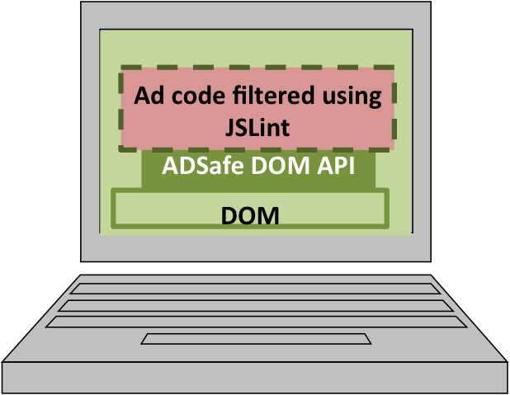
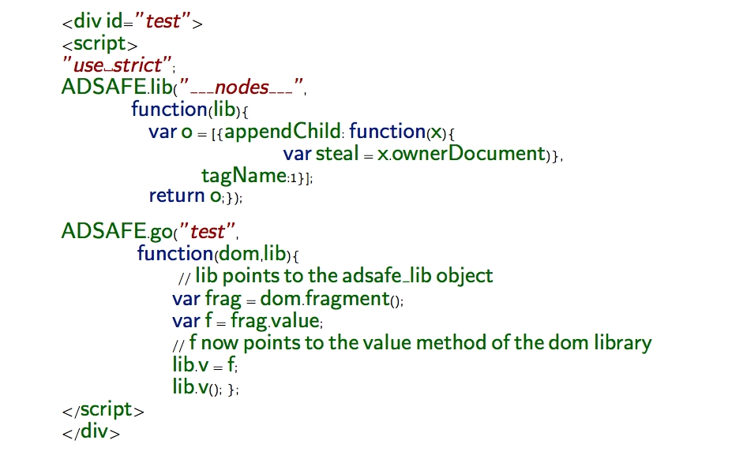
Application: Yahoo! ADSafe
ADSafe: Mechanism for safely embedding ads
This was an actual exploit
Sandbox: JSLint Filter
API: ADSAFE object
Result: ADSafe API safely confines DOM objects under the SES threat model, assuming the annotations hold
Security Goal: No direct access to the DOM
Analysis (1st attempt)
annotated the API implementation (2000 LOC)
desugared it to SES and ran ENCAP
obtained NOT CONFINED
culprits: ADSAFE.go and ADSAFE.lib
Analysis (2nd attempt)
fixed this bug
ran ENCAP again
obtained CONFINED

Slide 56
Concluding Remarks
and Future Directions

Slide 57
Concluding Remarks
JavaScript evolution
Five key security issues with ES3
Lack of lexical scoping
Lack of closure-based encapsulation (in implementations)
Ambient access to the global object
Mutable built-in state
Dynamic code generation
ES3 subsets use filtering and rewriting to achieve security
ES5-strict gets rid of the first three issues
SES gets rid of ALL of these issues
currently under proposal by the ECMA committee (TC39) for adoption within future version of JavaScript

Slide 58
Concluding Remarks
API + Language-Based Sandboxing
Promising approach for enforcing fine-grained access-control
sandbox needs to be designed only once
policies can be varied by modifying the API
security can be guaranteed by ONLY analyzing the trusted sandbox and API implementations
Out of scope: information-flow control
may require analysis of untrusted code
much harder problem!

Slide 59
Related Work
Semantics of JavaScript:
LambdaJS [Guha et al., 2010]: core calculus + desugaring function, much more “manageable” semantics, but surface language properties have to be translated into the calculus
JavaScript program analysis
Gatekeeper [Guarnieri et al., 2009]: points-to analysis like ours, no confinement analysis
VEX [Bandhakavi et al., 2010], Kudzu [Saxena et al., 2010], Progam logic for JS [Smith et al., 2012]
Language-based sandboxing (long history)
Proof Carrying Code, Software Fault Isolation, Inlined Run-time Monitoring, …
Our contribution: apply ideas from the above to JavaScript (tackle eval, reflection), automatically analyze confinement properties of JavaScript APIs
Browser-based mechanisms
Content security policy (Firefox), sandboxed IFrames (Chrome): get rid of most of the downsides of IFrame-based sandboxing

Slide 60
What next on this topic?
Over the last 4 years:
(Standardized) JavaScript has been evolving
we can enforce fine-grained access control
writing defensive code is easier, static analysis is feasible
Web application privileges have been growing
HTML5 geo-location, audio-video APIs, browser local storage, …
In the future:
Enforce information-flow control on third-party JavaScript
does an app flow location data to the internet?
Building blocks needed:
Program analysis techniques for JavaScript
Specifications for browser APIs

Slide 61
Two Future Projects
Program analysis techniques for JavaScript
Flow analysis, Symbolic execution frameworks, type systems
Begin with SES and then gradually move to arbitrary ES5 and ES3
Developing specifications for browser APIs
APIs come with implementation, test suite and English documentation
App
App
App
App
App
App
Windows8 SDK
Android SDK
iOS SDK
Windows8 OS
Android OS
Apple iOS
Approach: Automatically mine specifications for platforms SDKs
What global state get side-effected on invoking an SDK method?
What flows occur between the arguments and return value?
Techniques: Dynamic symbolic execution, Dynamic type inference
Related Work: RubyDust [Hicks et al.], MIX [Foster et al.], TAUTOKO [Zeller et al.], DIAKON [Ernst et al.], …

Slide 62
Collaborators
John C. Mitchell
(Stanford)
Sergio Maffeis
(Imperial College London)
Stanford Security Lab
Ulfar Erlingsson
(Google)
Mark S. Miller
(Google)
Jasvir Nagra
(Google)
Thank You

Slide 63
Inter-Component Isolation

Slide 64
Inter-Component Isolation
Sandbox Design Problem: ensure that all sandboxed components:
do not access any security-critical resources belonging to the hosting page
do not write to any heap location that the other component reads from
Alice
Bob
Security-critical
resources
Hosting page

Slide 65
Enforcing Inter-Component Isolation
FBJS Approach: Prefix all identifiers in Alice’s code by “$Alice_” and in Bob’s code by “$Bob_” (namespace separation)
Does not work! – can use built-in objects as communication channels
Alice: var $Alice_o = {}; $Alice_o.toString.ch = <msg>;
Bob: var $Bob_o = {}; $Bob_o.toString.ch;
Possible Fix: Make all built-in object properties readonly
Does not work! – Can use built-in functions to write to global object
Alice: $Alice_push = [].push; $Alice_push(<msg>)
Bob: $Bob_pop = [].pop; $Bob_pop()
...
Need a principled approach for reasoning about the set of access privileges held by Alice and Bob

Slide 66
Capability Safe Languages
Main Idea: Every program carries certain capabilities which are the sole means for designating and accessing resources
Object-Capability languages [Mark Miller et al.]
Capability is a reference to an object
Object reference graph is the access graph
Examples: Cajita (JavaScript), JoeE (Java), Emily (Ocaml)
Enforcing Inter-Component Isolation
capabilities determine the set of accessible resources
allocate capabilities so that the set of accessible resources are disjoint
intriguing, but not formally rigorous
How do we formalize this idea ?

Slide 67
Contribution
Object Capabilities and Isolation of Untrusted Web Applications
[Oakland’10]
Formally defined Capability-Safety for programming languages
Enforcing Inter-Component Isolation
Formally defined “Authority of a term”
Theorem: Authority-Isolation => Inter-Component Isolation
Identified a capability-safe sublanguage J_{safe} ⊆ES3
Developed a sandboxing mechanism for enforcing Authority-Isolation in J_{safe}
Google Caja
Formalized the core of the Cajita subset of JavaScript
Theorem: core Cajita is Capability-Safe

Slide 68
Other Research Projects
Safety and Stability Verification of Hybrid Systems
(with Ashish Tiwari, Sumit Gulwani)
Automated Synthesis of Processor Instruction Encodings
(with Patrice Godefroid)

Slide 69
Other Research Projects
Safety and Stability Verification of Hybrid Systems
(with Ashish Tiwari, Sumit Gulwani)

Slide 70
Hybrid System: Safety and Reachability
Systems with both continuous and discrete dynamics
Multiple modes each with its own continuous dynamics
specified using a differential equation: dx/dt = f_{i}(x) (f_{i} is Lipchitz continuous)
A discrete switching logic between modes
specified using guards g_{ij}(x)
Example: Thermostat (ON and OFF mode)
We are interested in Safety and Stability properties
Many other trajectories are possible
Thermostat
ON mode: dT/dt = +1
OFF mode: dT/dt = -1
Switching Logic
ON to OFF: T ≥ 75
OFF to ON: T ≤ 65
Initial State: T = 70
Temp
Safety
80
ON
ON
Stability
72
OFF
70
OFF
Safety
60
Time

Slide 71
Problem + Approach
Problem: Automatically verify safety and stability properties of polynomial hybrid systems
Approach: Deductive Verification (by solving ∃∀ constraints)
Safety: Exhibit Inductive Invariant
Stability: Exhibit Inductive Lyapunov Function
Use a template T(c, x) ≥ 0
At all points on boundary
T(c, x) = 0, field f must point “inwards”
▽T(c) . f > 0 (incomplete)
▽T(c) . f ≥ 0 (unsound)
…
Safety for single mode (dx/dt = f(x)) :
Find an invariant Inv
∀x: Init(x) => Inv(x) (Init)
∀x: Inv(x) => Safe(x) (Safe)
∀x: Inv(x) => Inv(Next(x)) (Ind)
Our result: relatively complete check for the class of convex invariants

Slide 72
References
Deductive Verification of Continuous Dynamical Systems [FSTTCS’09]
Synthesizing Switching Logic using Constraint Solving [VMCAI’09]
Switching Logic Synthesis for Reachability [EMSOFT’10]

Slide 73
Other Research Projects
Automated Synthesis of Processor Instruction Encodings
(with Patrice Godefroid)

Slide 74
Need for Symbolic Instruction Encodings
Symbolic Execution of Binaries
Static
Techniques: Verification Condition Generation, Bounded model checking, SuperOptimization
Tools: Boogie, SymDiff, …
Dynamic
Techniques: Test generation
Tools: SAGE, PEX, …
l1:mov eax, inp1
mov cl, inp2
shl eax, cl
jnz l2
jmp l3
l2: div ebx, eax
// Is this safe ?
// Is eax != 0 ?
l3: …
Notes:
What is symbolic execution ?
Symbolic exeution is execution of the program with symbolic rather than actual data values. In order to do this
we must have the transfer function or the meaning of each program statement as a symbolic expression.
Definiting program transformation symbolically, how data is being manipulated

Slide 75
Problem
Instruction
Bit Vector[X]
Bit Vector[Y]
Inp₁
?
Op₁
Inp_{n}
Op_{m}
Problem: Given a processor and an instruction name, symbolically describe the input-output relation corresponding to the instruction
Express the encodings as bit-vector constraints (eg: SMT-Lib format)

Slide 76
Approach + Result
Searches for a function f that respects truth table
Tricky!
Partial
Truth-table
Formula f
Sample inputs
(C with in-lined assembly)
Validated formula
Synthesis
engine
Validation
engine
Result: Automatically synthesized 512 encodings (outputs, EFLAGS, 8, 16, 32bits) for all the ALU instructions from the X86 architecture
Reference: Automated Synthesis of Symbolic Instruction Encodings from I/O Samples [PLDI’12]

Slide 77
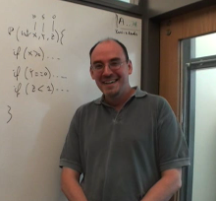
Collaborators
John C. Mitchell
(Stanford)
Sergio Maffeis
(Imperial College London)
Patrice Godefroid
(MSR Redmond)
Sumit Gulwani
(MSR Redmond)
Ashish Tiwari
(SRI International)
Ulfar Erlingsson
(Google)
Mark S. Miller
(Google)
Jasvir Nagra
(Google)
Thank You

Slide 78
Sandboxing Untrusted JavaScript
Ankur Taly
Stanford University
Joint work with
Sergio Maffeis, John C. Mitchell, Úlfar Erlingsson, Mark S. Miller and Jasvir Nagra
Ankur Taly

Slide 79
Problems for Future Research
Ankur Taly

Slide 80
API Correctness
API correctness: verify that all possible invocations of the API by sandboxed code, preserve an invariant on the (confined) security-critical resources
Sandboxed code
API
Protected resources

Slide 81
API Correctness: Example
function check(x){
if(x == “google.com”){return true}};
var api = {setLoc: function(x){
if (check(x)){window.location = x}};
};
Does window.location always get set to google.com?
NO! TOCTTOU bug
var o = {};
o.toString = function(){
this.toString = function(){
return “evil.com”};
return “google.com”}});
api.setLoc(o);

Slide 82
Defensive Consistency
Defensive Consistency: verify that the API always provides correct service to good components irrespective of any malicious components
Alice
Bob
API
Protected resources

Slide 83
Defensive Consistency: Example
var q = []; // even number queue
var api = {};
api.push = function(x){q.push()};
api.pop = function(){return q.pop()};
Alice
Bob
API
Protected resources
Specification: As long as you push even numbers, you pop even numbers
Is this API defensively consistent with respect to the specification ?
NO!
Bob: api.push(10);
Alice: api.push({a:1000});
Bob: api.pop(); // returns {a:1000} ☹

Slide 84
Evaluation
rew(s)
does not access any identifiers or properties from B
Filter & Rewriter
s
Third-party
Define J_{safe}(B) as ES3 with Identifer and Dot filters applied
Define rew: J_{safe}(B) →J_{safe}(B) using IDX rewriting
Let H be the heap obtained by executing the IDX initialization code
Hurdle: some global variables get accessed implicitly ☹
var o = { } // implicitly accesses Object
From the semantics, we obtain the set P_{implicit} of all such names ☺
Theorem: For all terms t ∈ J_{safe}(B) , rew(t) when executed on heap H does not access any identifier or property name from B \ P_{implicit}
Claim: For all terms t ∈ J_{safe}(B) , rew(t) when executed on heap H does not access any identifier or property name from B
Proof: by induction on reduction rules

