Slide 1
Verification of Authenticated Firmware Loaders
Sujit Kumar Muduli¹ , Pramod Subramanyan¹, Sayak Ray²
Indian Institute of Technology, Kanpur¹
Intel Corporation, Hillsboro, OR²
FMCAD-2019, San Jose
(Research funded in part by the Semiconductor Research Corporation)

Slide 2
Introduction
Authenticated Firmware Loaders
Secure boot process
booting malicious firmware can compromise whole system
Trusted firmware update
authenticates firmware updates on remote devices
Valid image
malicious image
secure boot process
updating remote device firmware

Slide 3
Example Protocol

Slide 4
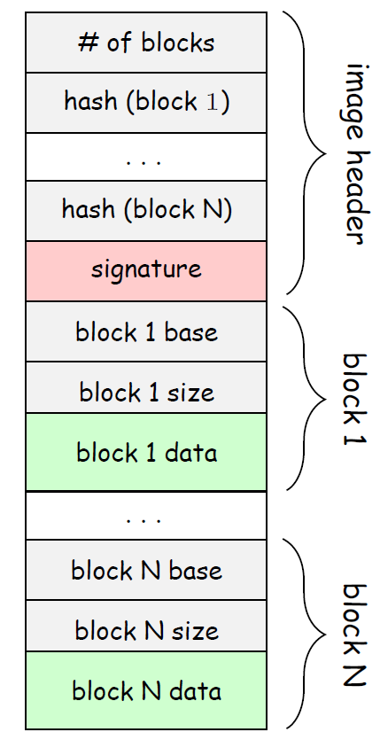
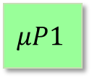
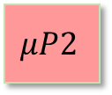
Example Protocol (SoC Platform)
Boot Image
$$μP1$$
$$μP2$$
Flash
AES
MMU
SHA256
RSA
ROM
N/W
trusted
RAM
un-trusted

Slide 5
Example Protocol (Image Format)
image header
contains hash of each data block
signature for header integrity
data block
base: memory address for a data block
size: size of the data block
data: payload to be stored

Slide 6
Example Protocol
start
loadHeader
check
header
loadBlock
invalidHeader
reloc block
loadNextBlock
gotoVerifyBlock
verify
block
invalidBlock
!(hasNextBlock)
abort
success

Slide 7
What are Potential Vulnerabilities?
State hijacking attack
TOCTOU attack
Confused deputy attack

Slide 8
State Hijacking Attack

Slide 9
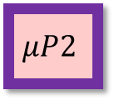
State Hijacking Attack
start
$$Header$$
$$μP1$$
$$Header$$
$$μP1$$
$$μP2$$
$$μP2$$
Flash
$$Block_{0}$$
$$Block_{0}$$
loadHeader
$$Block_{1}$$
$$Block_{2}$$
check
header
...
invalidHeader
$$Block_{n−1}$$
loadBlock
reloc block
AES
invalid image in Flash Storage
MMU
loadNextBlock
gotoVerifyBlock
SHA256
verify
block
invalidBlock
RSA
!(hasNextBlock)
abort
ROM
Protocol state variable location
N/W
success
RAM

Slide 10
TOCTOU Attack (Time of Check to Time of Use)

Slide 11

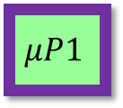
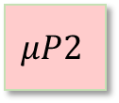
TOCTOU Attack (Time of Check to Time of Use)
start
$$Header$$
$$μP1$$
$$Header$$
$$μP1$$
$$μP2$$
$$μP2$$
Flash
$$Block_{0}$$
$$Block_{0}$$
loadHeader
$$Block_{1}$$
$$Block_{1}$$
check
header
$$Block_{2}$$
...
invalidHeader
$$Block_{n−1}$$
loadBlock
reloc block
AES
MMU
loadNextBlock
gotoVerifyBlock
SHA256
verify
block
invalidBlock
RSA
ROM
!(hasNextBlock)
abort
N/W
success
RAM

Slide 12
TOCTOU Attack (Time of Check to Time of Use)
RAM
Preventing TOCTOU attack
mark image locations in RAM as READ_ONLY for others
still vulnerable to Confused Deputy attack
accelerators:
READ/WRITE permission to protocol firmware
attacker:
READ_ONLY permission to others

Slide 13
Confused Deputy Attack

Slide 14
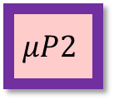
Confused Deputy Attack
start
$$μP1$$
$$Header$$
$$μP2$$
$$μP2$$
Flash
$$Block_{0}$$
loadHeader
$$Block_{1}$$
$$Block_{2}$$
check
header
No write permission
...
invalidHeader
$$Block_{n−1}$$
loadBlock
reloc block
AES
MMU
loadNextBlock
gotoVerifyBlock
SHA256
Trusted accelerators have R/W permissions
$μP2$ can make them to write data to target location in RAM
verify
block
invalidBlock
RSA
$$Header$$
!(hasNextBlock)
abort
ROM
$$Block_{0}$$
N/W
$$Block_{1}$$
success
RAM

Slide 15
Challenges in Specification

Slide 16
Challenges in Specification
A strawman property specification to capture protocol security
“authentication succeeds
if and only if
Image binary has valid header and each block has a valid hash”
starts with valid image
tamper header
tamper data block
loads malicious firmware
{start}
{load header}
{check header}
{reloc block}
{verify block}
{success}
implementation satisfying the property could still be vulnerable to TOCTOU and confused deputy attacks

Slide 17
System Model

Slide 18
System Model (w/o Adversary Model)
Property :
“if image is authenticated successfully, then it is a valid image.”
start
loadHeader
$$σ_{0}$$
$$σ_{i}$$
$$σ_{i+1}$$
$$σ_{1}$$
check
header
loadBlock
invalidHeader
reloc block
(trace for valid image)
loadNextBlock
gotoVerifyBlock
verify
block
invalidBlock
!(hasNextBlock)
abort
(trace for invalid image)
success

Slide 19
System Model + Adversary Model
Boot Loader in adversarial setting
start
$$M_{adv}= BootLoader∘MalciousProgram$$
loadHeader
check
header
$$tx∘tmpr$$
loadBlock
invalidHeader
reloc block
loadNextBlock
gotoVerifyBlock
verify
block
invalidBlock
$$tmpr$$
$$tx$$
!(hasNextBlock)
abort
Tamper relation (tmpr) : captures adversary actions
arbitrary memory write operations (image tampering)
RowHammer attack (model using bitflips)
actions of untrusted software components
success
Boot Loader

Slide 20
System Model
Verifying Boot Loader in adversarial setting
accept
$$π_{1}∈Traces(M_{adv})$$
same boot image
≈
≈
≈
$$…$$
≈
accept
$$π_{2}∈Traces(M)$$
For all $π_{1}∈Traces\left(M_{adv}\right)$ there exists corresponding $π_{2}∈Traces\left(M\right)$ s.t.
$$accept\left(π_{1}\right)⟹accept(π_{2})$$
$$exec\left(π_{1}\right)⟹exec(π_{2})$$
Quantifier Alternation
(presence of both $∀$ and $∃$ difficult to verify)

Slide 21
System Model
Addressing quantifier alternation issue
Construct an overapproximate model ($M_{adv+})$
Adversary actions : {tmpr, NOP}
$M$ and $M_{adv}$ refines $M_{adv+}$

Slide 22
System Model
Addressing quantifier alternation issue
Decompose security property into easier to verify 2-safety properties
No Hijacking Property
No TOCTOU Property

Slide 23
Verifying Overapproximated Model
2-Safety Property to verify : No state hijacking
tmpr
accept
$$π_{1}$$
tx
tmpr
same boot image
NOP
tx
NOP
$$π_{2}$$
$$σ_{0}$$
$$σ_{0}$$
accept
$$accept\left(π_{1}\right)⟹accept(π_{2})$$
Counterexample Trace
tmpr
accept
$$π_{1}$$
tx
abort
NOP
tx
NOP
$$π_{2}$$
$$σ_{0}$$
$$σ_{0}$$
Notes:
$∀π_{1} ,π_{2}∈Traces\left(M_{adv+}\right)$
If
Both have same initial images : ${img(π}_{1}[0])=={img(π}_{2}[0])$
$π_{2}$ has no $tmpr$ action : $π_{2}∀i. tmprNOP(π_{2}[i])$
Then,
success $\left(π_{1}\right)⟹success(π_{2})$

Slide 24
Verifying Overapproximated Model
2-Safety Property to verify : No TOCTOU
accept
$$π_{1}$$
tx
same boot image
$≈_{exec}$
$≈_{exec}$
$≈_{exec}$
$≈_{exec}$
$$π_{2}$$
$$σ_{0}$$
$$σ_{0}$$
NOP
tx
NOP
accept
Image data doesn’t get tampered by adversary

Slide 25
Verifying Overapproximated Model
2-Safety Property to verify : No TOCTOU
accept
$$π_{1}$$
tx
$≈_{exec}$
$≈_{exec}$
$≈_{exec}$
$≈_{exec}$
NOP
tx
NOP
$$π_{2}$$
$$σ_{0}$$
$$σ_{0}$$
accept
Counter Example Trace
tmpr
accept
$$π_{1}$$
tx
$≈_{exec}$
$≈_{exec}$
$$exec\left(π_{1}\right)≠exec(π_{2})$$
$$π_{2}$$
NOP
tx
NOP
$$σ_{0}$$
$$σ_{0}$$
accept

Slide 26
Verifying Overapproximated Model
$M_{adv}$and $M$ refines $M_{adv+}$
${M_{adv+}}_{ }$satisfies $No State Hijacking$ and $No TOCTOU$
$M_{adv}$ and $M$ satisfies the security property

Slide 27
Non-Interference for Security Protocols
Noninterference properties describes strong security requirements
E.g. regardless of what the adversary’s actions are, the system must boot a valid image
accept
$$π_{1}$$
tx
NOP
tx
NOP
$$π_{2}$$
$$σ_{0}$$
$$σ_{0}$$
accept
$$accept\left(π_{1}\right)⟺accept(π_{2})$$

Slide 28
Results
The protocol, adversary actions and properties are modeled using UCLID5
Bit Width | No state hijack property | No TOCTOU property | Standard safety property verified compositionally
 |  |  | (a) | (b) | (c)
8 | 4.3s | 5.2s | 8.2s | 3.0s | 2.8s
12 | 4.9s | 12.9s | 12.1s | 3.0s | 2.7s
16 | 4.6s | 15.0s | 9.0s | 3.4s | 2.9s
24 | 6.4s | 13.8s | 26.2s | 3.4s | 3.2s
32 | 7.8s | 16.5s | 18.5s | 4.3s | 3.2s

Slide 29
code https://bitbucket.org/spramod/verif-auth-loader/src/master/

