Slide 1
Input Elimination Transformations for Scalable Verification and Trace Reconstruction
Raj Kumar Gajavelly, Jason Baumgartner, Alexander Ivrii, Robert L Kanzelman, Shiladitya Ghosh
FMCAD 2019

Slide 2
Motivation: Transformation Based Verification (TBV)
Design + Driver + Checker
Trace on original design
Reductions (transformations) are critical for scalable model checking in industrial applications
Transform the netlist until tractable to solve
Many different transformation algorithms: input elimination techniques, retiming, phase abstraction, bitwidth reduction, equivalent gate merging, localization, …
Counterexamples must be consistent with the original design
Resource-intensive to reconstruct Semi-Formal traces
In this work we present two new input elimination techniques with trivial trace reconstruction
140,627 registers
Combinational Optimization Engine
Model Checker
119,147 registers
trace on optimized design
Retiming Engine
trace on optimized+retimed design
100,902 registers
We need more/new transformations
Especially taking trace reconstruction into account
IC3 Engine
Semi-Formal Engine

Slide 3
Overview
Motivation
Contribution 1: Input Reparameterization without Logic Insertion
“merging inputs to constants when the changes are not observable at outputs’’
Contribution 2: Sequentially-Unate Input Reduction “merging inputs to constants while retaining existence of counterexamples”
Connectivity Verification Experiments
Conclusion

Slide 4
Cuts
A cut of the netlist is a set of nodes
A cut C dominates a node n iff every path from n to primary outputs/next-state variables goes through a node in C
Two types of cuts are usually considered:
min-cuts: minimum-size cuts between primary inputs and primary outputs/next-state variables
dominators: single-output cuts
(efficient algorithms exist for computing min-cuts and dominators)
Given a cut, we consider its combinational fanin, and differentiate between
Inputs dominated by the cut (“can control these”)
Registers and non-dominated gates (“cannot control these”)

Slide 5
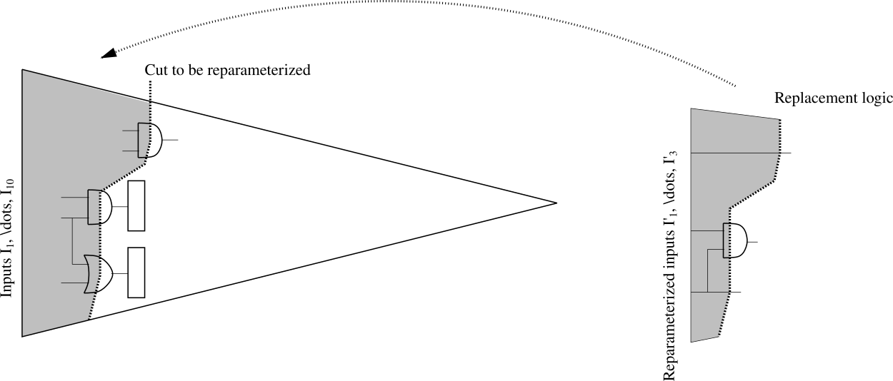
General Input Reparameterization
Given a cut C, with dominated inputs Y and non-dominated gates Z
Compute the range of the cut in terms of Z
Synthesize a replacement logic producing identical range (over new inputs; at most |C| inputs are needed)
Replace the original logic cut with the replacement logic
If |Y| > |C|, reduces input count, often also register count
Reference: Baumgartner and Mony, CHARME’05

Slide 6
Fast Input Reparameterization
Let F(Y, Z) define a single-output cut, with dominated inputs Y and non-dominated gates Z
If for every assignment Z
there exist an assignment Y₀ with F(Y₀, Z) = 0 and an assignment Y₁ with F(Y₁, Z) = 1,
then F can be replaced by a new primary input Ynew
A$s 2QBF:F can be replaced by a new primary input if ∀Z ∃Y0,Y1 (¬F\left(Y0, Z\right) ∧ F\left(Y1, Z\right)$)
Example:
More generally, F can be always resynthesized using a single input as $¬F_{0}\left(Z\right)∧$ ${(F}_{1}\left(Z) ˅{ Y}_{new}\right)$, where $F_{0}\left(Z\right)=∀Y¬F\left(Y, Z\right) and$ $F_{1}\left(Z\right)=∀Y F\left(Y, Z\right)$
Y
F
Y_{new}
F
Z
Reference: Een and Mishchenko, DIFTS’13

Slide 7
Input Reparameterization: Challenges
Range computation can be expensive
CHARME05: use BDDs to compute range of multi-output min-cuts
DIFTS13: use truth-tables to compute range of 1-output, 8-input dominators
MUCH faster, though lossy: can’t reduce multi-output cuts
Trace reconstruction can be expensive: lifting the counterexample to the original netlist is typically performed by calling a SAT-solver (on the original logic cut) to find valuation to original inputs producing the same valuation to cut gates
E.g., if logic is XOR-rich and pathological for SAT solving
Especially if the trace is LONG, e.g. coming from semi-formal falsification
Done once per counterexample: benchmarks with many fails can be runtime-dominated by trace reconstruction
Nevertheless, input reparameterization techniques yield substantial verification speedups
Typically beneficial to iterate the two: maximal reductions with minimal resource
Often interleaved with logic optimization, localization

Slide 8
Contribution 1: Reparameterization without Logic Insertion
Idea: simplify netlist by merging inputs to constants while preserving range
Let C be a cut with at least 2 dominated inputs x, Y and non-dominated gates Z
If for every assignment Z
every range value producible with x=1 can be also produced with x=0 (by varying values of other dominated inputs Y),
then x can be merged to 0
(and similarly for merging x to 1)
As 2QBF:
x can be merged to 0 iff
$∀Z, Y ∃Y^{′}(F\left(1, Y, Z\right)=F\left(0, { Y}^{′}, Z\right))$
x can be merged to 1 iff
$∀Z, Y ∃Y^{′}\left(F\left(0, Y, Z\right)=F\left(1, { Y}^{′}, Z\right)\right)$

Slide 9
Examples
Example 1: y1, y2 – dominated, z – non-dominated
z
z
y1
F
y1
F
y2
0
Can merge y2 to 0 (alternatively, can merge y1 to 0)
Example 2: y1, y2 – dominated
y1
y1
F
F
y2
0
Can merge y2 to 0 (alternatively, can merge y2 to 1, or y1 to 0, or y1 to 1)
Example 3: if in the above example, y1 is not dominated, then our reduction does not apply (while fast reparameterization does apply)

Slide 10
Efficient SAT-based implementation
Recall: x can be merged to 0 iff 2QBF $∀Z, Y ∃Y^{′}(F\left(1, Y, Z\right)=F\left(0, { Y}^{′}, Z\right))$ is true
Simple scheme: first SAT-solver enumerates range values produced with x=1; second SAT-solver checks if these range values can be also produced with x=0
Improved scheme: first SAT-solvers enumerates range values produced with x=1 such that changing x from 1 to 0 changes at least one value in the range; second SAT-solver checks if these range values can be also produced with x=0
Create F’(1,Y,Z) copy of cut with x = 1, F”(0,Y,Z) copy of cut with x = 0; enumerated = {emptyset}
while (!resource_exceeded)
if IsSAT((F’ ≠ F”) & !enumerated) == SAT then
r = assignment projected to F’ and Z
if IsSAT(F” & r) == UNSAT then return “Cannot Merge! r unreachable with x=0”
else: Add r to enumerated
else: merge x to 0, return “Merged!”

Slide 11
Efficient SAT-Based Implementation: Example
Create F’(1,Y,Z) copy of cut with x = 1, F”(0,Y,Z) copy of cut with x = 0; enumerated = {emptyset}
while (!resource_exceeded)
if IsSAT((F’ ≠ F”) & !enumerated) == SAT then
r = assignment projected to F’ and Z
if IsSAT(F” & r) == UNSAT then return “Cannot Merge!”
Add r to enumerated
else merge x to 0, return “Merged!”
Example: OR gate $F\left(x,{y, z}_{1},…z_{n}\right),$ with $x,y$ dominated inputs, $z_{1},…z_{n}$non-dominated, to merge $x=0$
First SAT Query1: $F′\left(x=0,{y, z}_{1},…z_{n}\right)≠$ $F′′\left(x=1,{y, z}_{1},…z_{n}\right)$
Line 3 is SAT when ${y, z}_{1},…z_{n}$ are all 0, r shows 1 on F’ due to x’ = 1 x’’ = 0
Line 5 is SAT with y” = 1; Line 6 add {Z = 00… & F’ = 1} to enumerated
Repeat SAT Query2: ($F′\left(x=0,{y, z}_{1},…z_{n}\right)≠$ $F′′\left(x=1,{y, z}_{1},…z_{n}\right)$) & !{Z = 00… & F’ = 1}
Line 3 is now UNSAT ; line 7 performs the merge with incomplete range enumeration
Cofactor dominated input x: reduction candidate
x
Allow dominated input y to vary
y
z₁
F
.
.
.
z_{n}

Slide 12
Efficient Implementation Tricks
Only need to duplicate logic in fanout of x and Y. Cofactor x vs compare to original logic to simplify SAT instance
Create F’(1,Y,Z) copy of cut with x = 1, F”(0,Y,Z) copy of cut with x = 0; enumerated = {emptyset}
while (!resource_exceeded)
if IsSAT((F’ ≠ F”) & !enumerated) == SAT then
r = assignment projected to F’ and Z
if IsSAT(F” & r) == UNSAT then return “Cannot Merge!”
Add r to enumerated
else merge x to 0, return “Merged!”
Resource-bound by limiting #iterations, vs size of cut . Often useful to preclude analyzing cuts in fanout of previous resource-exceeded cuts; likely to also exceed resources
SAT solver 1: enumerated blocked using clauses
SAT solver 2: r passed using assumptions
Eagerly merge every proven-valid reduction, to ensure reduction-compatibility across candidate inputs and to accelerate later analysis. Straight-forward to parallelize

Slide 13
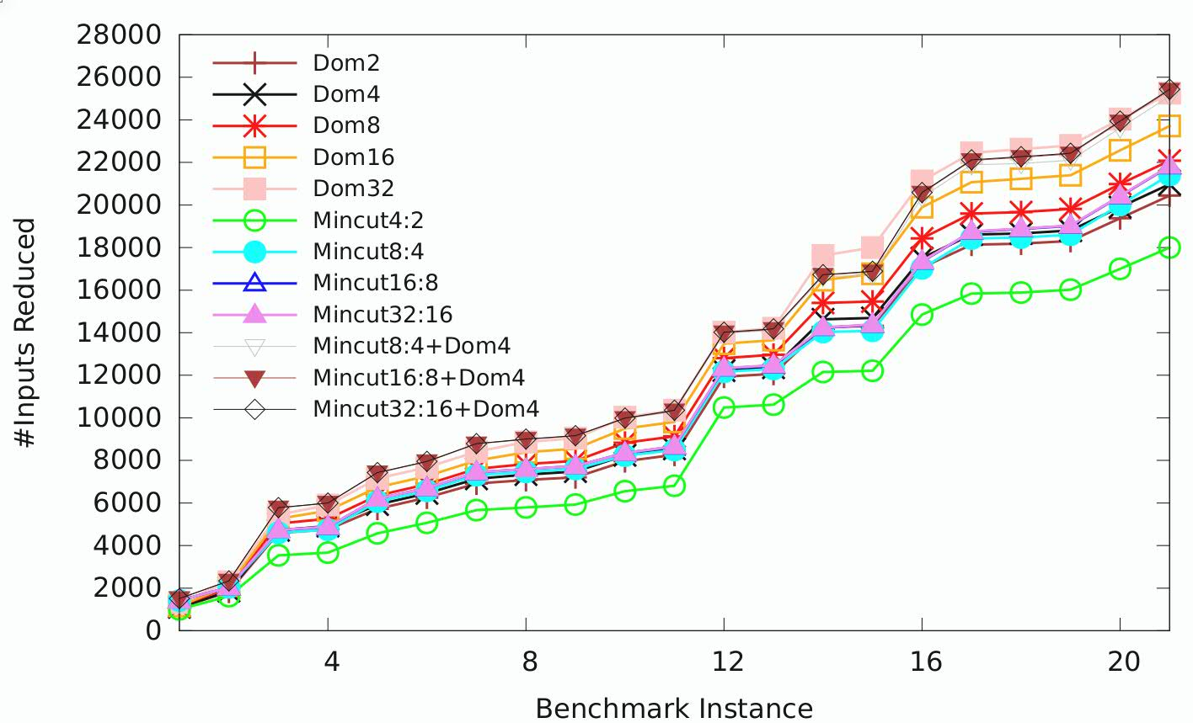
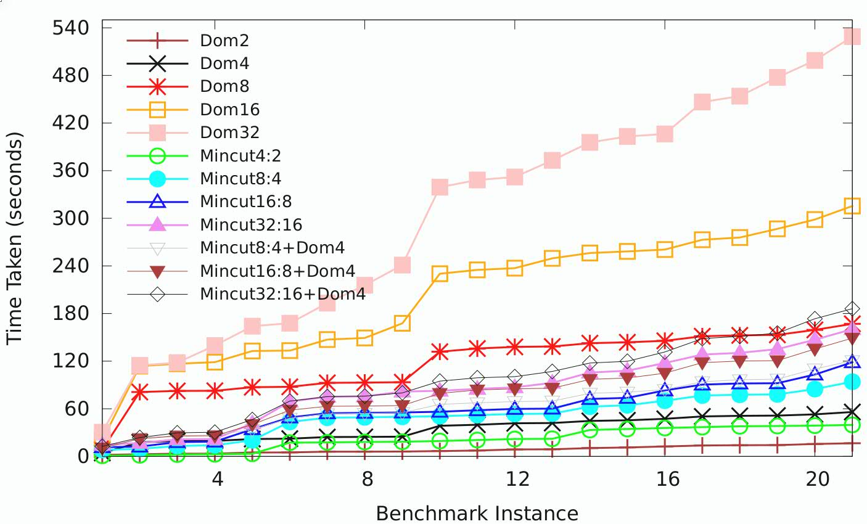
Experimental Results: most useful cuts and parameters
IBM + HWMCC benchmarks; pre-simplified without reparameterization
Dom: candidate cuts are single-output dominators
Dom#: # bounds number of nondominated gates
Mincut: candidate cuts are min-cuts
Mincut#1:#2: #1 is cut-width, #2 is #nondominated gates
Mincut + Dom: dominator-based after mincut-based
Interesting conclusions:
Limiting #dominated inputs is not useful, unlike traditional reparameterization
Smaller #s are faster, with marginally lesser reduction
Dom32, 16 slowest by far
Even large mincuts are much faster (next slide)
Fastest maximal reductions use mincut followed by dominators
#Inputs Reduced
Runtime (seconds)

Slide 14
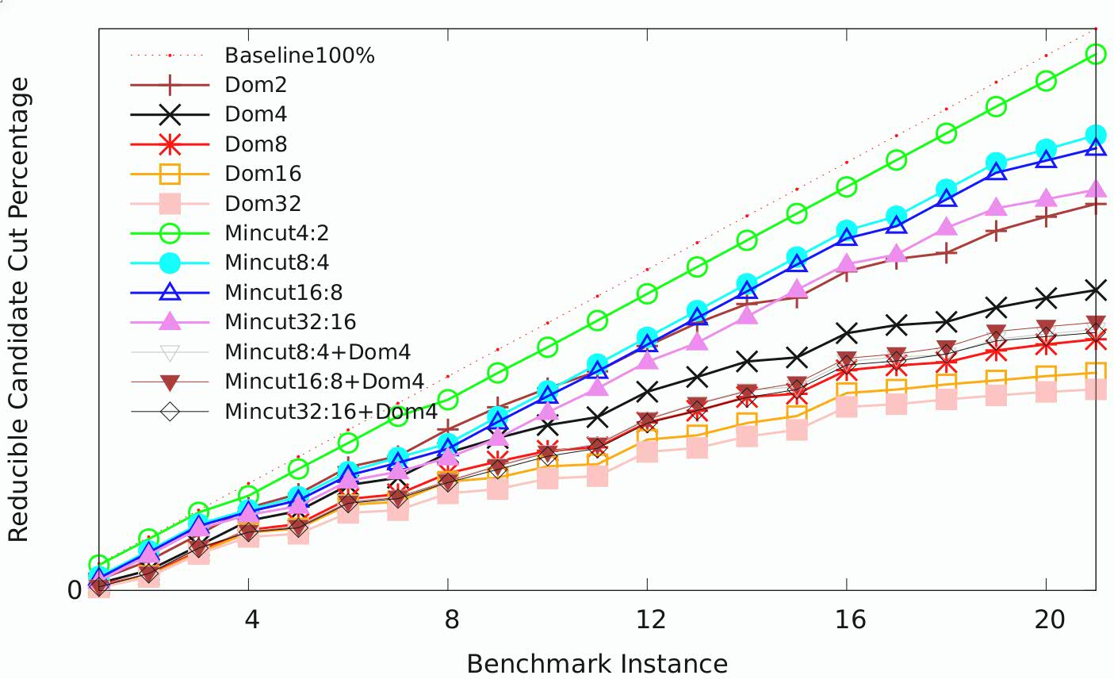
Experimental Results: Success Rate
#Inputs Reduced
#Cuts Reduced / #Cuts Analyzed
Cuts with larger #dominated inputs vs. cut-width, and fewer nondominated gates, are more-likely reducible
Processing reducible cuts first, and skipping irreducible cuts, vastly improves runtime
Mincut cuwidth=4 is very fast: >90% success rate, but least input reduction
Dom32 yields strong reductions, but lowest success rate and largest runtime
Best reductions with fastest runtime: use faster + higher-success-rate options first, then repeat with heavier options

Slide 15
Trace Reconstruction Speedup
Trace reconstruction time: our technique as preprocessing + traditional reparameterization (y axis) vs traditional reparameterization alone (x axis)
Trace lifting is usually fast with traditional reparameterization, but sometimes very expensive
XOR-rich logic pathological for SAT; deep counterexamples; single benchmarks with many counterexamples
29.6X faster average, up to 11808.3X faster per trace

Slide 16
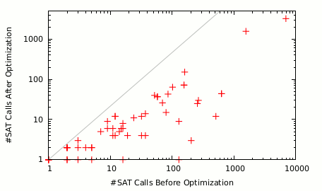
Incomplete Range Computation
#SAT enumerations for simple (y axis) vs improved (x axis) range computation on reducible HWMCC cuts
2.2X average reduction, up to 129.0X
Much greater reduction for irreducible cuts

Slide 17
Reparameterization without Logic Insertion: Summary
Simplifies netlist by merging inputs to constants
Efficiently yields a subset of reparameterization reductions, without expensive range computation and trace reconstruction
Often used as a lossy preprocess to reparameterization, or interleaved with: more reduction with less runtime
Avoiding expensive range computations:
Improved range-enumeration algorithm
Use resource-constrained SAT queries of arbitrarily-large netlist cuts
Not limited to small cuts as with truth-tables
Often much more scalable than BDDs, especially for XOR-rich highly-controllable/dense-range cuts
Use fast-and-lossy options to quickly yield most of the achievable reductions
Aggressive options to yield reductions impractical with traditional reparameterization
Trivial trace reconstruction: just propagate merged-to constant value for each merged input
Obviate custom reduction orchestration for proving vs. bug-hunting to cope with slow trace reconstruction
Enable bug-hunting to benefit from reparameterization, without trace reconstruction penalty

Slide 18
Unate Functions
From literature: given a Boolean function $F\left(x, Y\right)$
x is positive unate if $∀Y F\left(x=1, Y\right)≥F(x=0, Y)$
x is negative unate if $∀Y F\left(x=0, Y\right)≥F\left(x=1, Y\right)$
x is binate if neither positive nor negative unate
Examples:
$\left(x ˅ ¬y\right)$: x is positive unate, y is negative unate
$\left(x ⊕ y\right)$: both x and y are binate
Adapting this definition to combinational netlists (i.e. no registers) is easy:
x is positive unate if it is positive unate with respect to every property and constraint
x is negatively unate if it is negatively unate with respect to every property and constraint
Theorem: in a combinational netlist
If x is positive unate, then x can be merged to 1
If x is negative unate, then x can be merged to 0
Trivially-fast trace reconstruction: propagate the merged-to constant value for each merged input

Slide 19
Contribution 2: Leveraging Unateness in Sequential Netlists
For sequential netlists we consider the notation of unateness based on structural analysis across registers:
Let x be a primary input
x is called sequentially positive unate if the number of inversions along every structural path (of any length) from x to every property and constraint is even
x is called sequentially negative unate if the number of inversions along every structural path (of any length) from x to every property and constraint is odd
Theorem:
If x is sequentially positive unate, then x can be merged to 1
If x is sequentially negative unate, then x can be merged to 0
Again, trivially-fast trace reconstruction

Slide 20
Unateness Examples
Example 1:
P
x
$$R_{0}$$
$$R_{1}$$
$$R_{2}$$
x is sequentially positive unate
However, x is not (combinationally) positive unate in R₀
can merge x to 1
P
Example 2:
x
$$R_{0}$$
$$R_{1}$$
$$R_{2}$$
x is sequentially negative unate
can merge x to 0
Example 3:
P
x
$$R_{0}$$
$$R_{1}$$
$$R_{2}$$
Paths from x to P exist both with an even and an odd number of inversions
x is sequentially binate
can’t merge

Slide 21
Sequentially-Unate Input Reduction (SUR)
Analysing (structurally) the polarity on each path from an input to each property, across latches/registers
Linear-time algorithm; any input affecting properties/constraints in “at most one polarity” is sequentially-unate and reducible
sequentiallyUnateInputReduction(netlist N)
for each property and constraint gate g
markPolarityAIG(g, positive)
for each input x
if getPolarity(x) ≠ {positive, negative} then // x is sequentially-unate
merge x to (getPolarity(x) ≡ {positive}) ? constant_ONE : constant_ZERO
markPolarityAIG(gate g, polarity p)
if isInverted(g) then p ← ¬p; g ← uninvert(g)
if getPolarity(g) covers p then return // already marked
addPolarity(g, p)
for each gate-input i of g
markPolarityAIG(i, p)

Slide 22
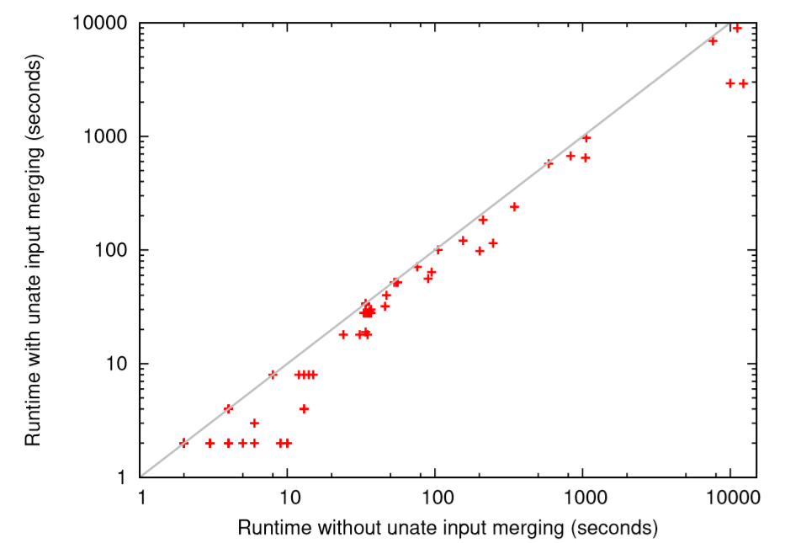
Verification Speedup with SUR
Benchmark | Inputs | Ands | Unate Inputs | Unate Ands | Solving Time (sec) | Reduced Solving Time (sec)
oski2ub5i | 13231 | 174682 | 16 | 24 | 12250.4 | 2908.4
6s429 | 13335 | 419135 | 18 | 38 | 9994.1 | 2930.4
oski4ui | 11836 | 122438 | 24 | 48 | 11153.8 | 8950.5
oski5ui | 3175 | 24689 | 6 | 12 | 7627.5 | 6917.7
6s301 | 1048 | 101655 | 8 | 22 | 1046.1 | 647.9
6s115 | 1966 | 121473 | 684 | 44545 | 831.5 | 673
bob1u05cu | 100 | 17647 | 61 | 183 | 248.7 | 115.9
mentorbm1 | 164 | 24996 | 93 | 711 | 346.1 | 240.2
bob05 | 100 | 17647 | 61 | 183 | 201.4 | 98.9
6s143 | 425 | 13928 | 3 | 3 | 1061.9 | 970.5
6s310r | 86 | 3014 | 8 | 15 | 155.6 | 121.1
oski1rub03 | 13074 | 109711 | 40 | 48 | 90 | 56.4
oski1rub07 | 13071 | 109665 | 40 | 64 | 95 | 64.5
6s8 | 86 | 3016 | 8 | 15 | 212.9 | 184.6
nusmvtcastp2 | 146 | 2744 | 2 | 2 | 35.8 | 18.8
nusmv.tcast2.B | 146 | 2744 | 2 | 2 | 34.9 | 19.6
HWMCC17 Benchmarks with unate inputs
Excluding some mentorbm* benchmarks having 56% average SUR inputs
Sequential input reduction verification speedup: up to 4.2x and 36% average

Slide 23
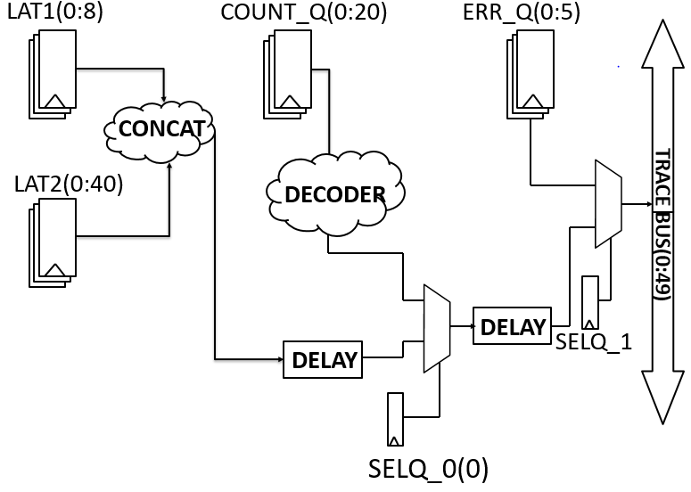
Connectivity Verification
Verifies trace bus logic, sometimes called debug bus verification
Intertwined with functional logic
Enables post-Si observability and performance monitoring
Automated testbench creation from post-Si “templates” detailing observability configurations
Involves creating a reference trace bus against which implementation is compared
Risk subtle “design instrumentation” bugs: clocking / latching / power-savings problems, hierarchy-spanning compatibility problems, …
Often verified at full core- or chip-level to cover such problems
Interaction with functional logic undermines most scalability boosts such as “domain reduction”

Slide 24
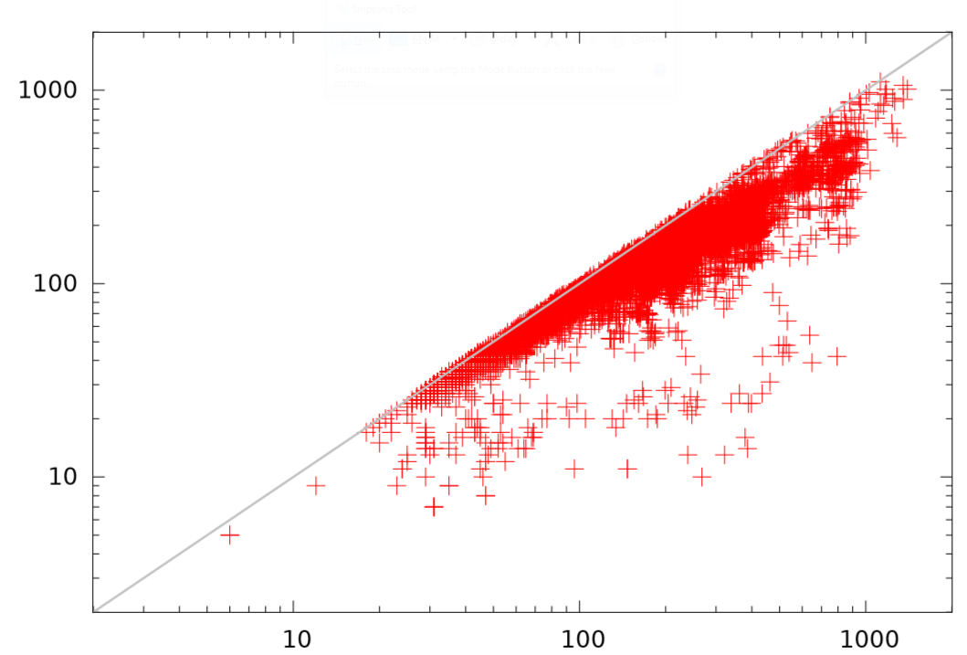
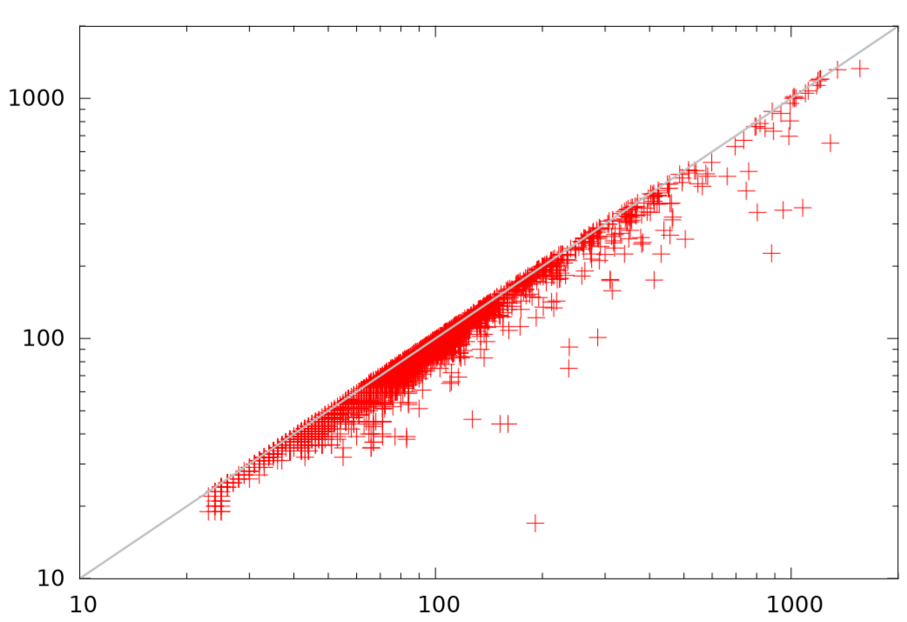
Connectivity Verification SUR Reductions
Localization is very helpful at placing cutpoints (removing logic) without affecting provability
Many of these cutpoints are sequentially unate and trigger additional reductions
Reduction in Inputs
Reduction in ANDs
Reduction in Registers
Netlist size passing into IC3 after aggressive reductions without SUR (x axis) vs with SUR (y axis)
#inputs, #ANDs, #registers reduced up to 27.6x, 11.2x, 21.6x respectively

Slide 25
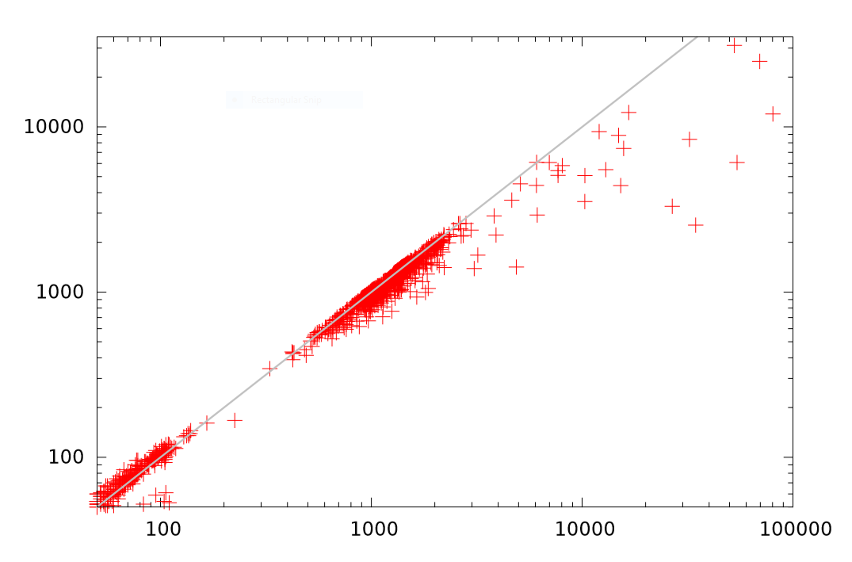
Connectivity Verification Reduction Speedups
Comparing traditional reparameterization vs our techniques
Benchmark | Inputs | Ands | Registers | Traditional Reparam. Inputs/Time(sec) | New Input Elimination Inputs / Time (sec)
DBV1 | 22256 | 1138339 | 112161 | 6154 / 62.3 | 1546 / 19.1
DBV2 | 21435 | 4429287 | 456243 | 1799 / 2.2 | 400 / 1.5
DBV3 | 24111 | 1209308 | 115676 | 7406 / 63.2 | 1580 / 18.1
DBV4 | 22456 | 1136918 | 111966 | 6416 / 79.3 | 1547 / 19.5
DBV5 | 20457 | 1110112 | 109463 | 5670 / 49.7 | 1472 / 27.7
DBV6 | 24320 | 5351515 | 1980356 | 2212 / 4.7 | 333 / 0.5
DBV7 | 24168 | 5391085 | 2035734 | 2219 / 12.1 | 319 / 0.6
Runtime without SUR reduction (in seconds)
SUR verification speedup
Benchmark | Localized Inputs | Localized ANDS | Localized Registers | Unate Inputs | Unate Ands | Unate Registers | Solving Time (sec) | Reduced Solving Time(sec)
DBV1 | 13728 | 115163 | 12839 | 12839 | 112849 | 12465 | 14906.1 | 7451.2
DBV3 | 16064 | 157329 | 15612 | 11923 | 156636 | 14923 | 29799.8 | 14037.5
DBV4 | 14395 | 122873 | 12664 | 13486 | 120279 | 12591 | 25213.4 | 8721.7
DBV5 | 14078 | 135856 | 13110 | 10431 | 135511 | 13043 | 10629.4 | 9797.1
Our techniques + traditional reparameterization achieve up to 99.8% input reduction, verification runtime speedup of 13.2x
Runtime with SUR reduction (in seconds)

Slide 26
Conclusions
Presented two novel sound and complete input elimination transforms with trivial trace reconstruction
2QBF-based input elimination, “reparameterization without logic insertion”
Often faster than multi-output traditional reparameterization; obviates full range computation
Orders of magnitude speedup to traditional reparameterization’s trace reconstruction, when used as a preprocessing transform
Sequentially-unate input reduction
Structural technique, linear runtime
On classes of benchmarks e.g. connectivity verification, achieves up to 99.8% logic reduction
Both are fast enough to include in generic “logic optimization” orchestration phase
Boost scalability of end-to-end proof and bug-hunting model checking flows

Slide 27
Questions?

